Slide 1



Slide 2
Agenda
Youth Services Staff Introductions
Community Check-In
Purpose of SCSP
Program Overview
Documentation Requirements
Application Process
Reimbursement Guidelines
Questions/Closing Remarks
Notes:
JaVona

Slide 3

YSD Staff Introductions
Elisa Cramer
Department Director
Valerie Messineo
Sanctuary
Program Coordinator
Ike Powell
Division Director OCP
Annette Santiago
Administrative Assistant
Tamia Williams
Senior Program Specialist
JaVona Wilson
Senior Program Specialist
Djenane Saintyl
Program Coordinator
Markus Lockhart
Program Coordinator
Jamie Green
Paraprofessional
Caleiyah Laws
Paraprofessional
Dani Greenberg
Paraprofessional
Notes:
All YSD Staff

Slide 4

Youth Services Department is Sanctuary Certified www.menti.com Enter code: 6487 1227
Community Meeting
Community Meeting:
How are you feeling?
What is your goal for this meeting?
Who can you ask for help?
What’s your favorite holiday pie?
Notes:
Valerie

Slide 5
Purpose
The Summer Camp Scholarship Program provides full-tuition and fees for summer camp for children residing in families with income at or below 185% of Federal Poverty Guidelines.
It gives children educational and recreational opportunities for growth.
Parents may choose from participating camps throughout Palm Beach County.
Serving children 5 -17 years old
Notes:
JaVona

Slide 6
Why Partner with SCSP?
Gives providers the opportunity to support low-income families and specialized populations by offering a safe environment throughout the summer months
Help students avoid falling victim to the “summer slide”
Offers firsthand support from the Youth Services Department and our community network
Includes tickets to the exclusive Super Summer Spelling Bee (a free event)
Provides access to Prime Time ELOs
Offers free training opportunities
Builds connections with Palm Beach County agencies and organizations
Notes:
JaVona

Slide 7
Program Overview
Prior to Summer Start
Step 1 Provider applies for participation in SCSP & approved based on eligibility
Step 2 Parents/Agencies apply for Scholarship (YSD Staff to review applications)
Step 3 Approved applicants accept Scholarship
Step 4 Provider accepts or rejects campers
Step 5 Parent Completes Registration with Provider (Registration fee up to $30 per camper)
Step 6 Provider Confirms Registration with SCSP
Please note approved providers are required to attend mandatory Provider meetings (January and April).
Notes:
JaVona to present
Any requests made after mid-cycle will be reviewed on a case by case basis

Slide 8
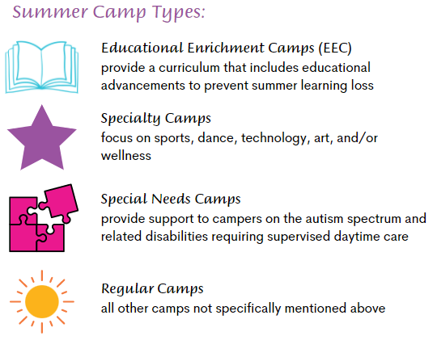
Program Overview
Notes:
JaVona-

Slide 9

Required Documents
Certification of Insurance COI
DCF Affidavit of Compliance (Level 2)
PBCSD Only: List of employees on letterhead
Sun-biz (if applicable)
W-9
Fire Inspection
Proof of Experience – 2 Years (New Camps)
Health Dept License (Year-Round Providers)
ACH Form and Voided Check
First Aid/CPR (minimum 2 staff)
Daily Activity Schedule
NOTE: All documents must be current
Notes:
JaVona to present
These are a few of the required documents that providers need to submit with their application in order to be determine eligibility.
If there are required items on the application that do not apply to your camp; you need to upload a document (preferably on letterhead) that says this does not apply to this camp. Otherwise, we will think that you missed an area and your application will be returned.

Slide 10
Additional Documents
501(c)(3) (if applicable)
Field Trip Safety Policy
Field Trip List
Registration Forms/Packet
Behavior Policy
EEC Providers:
Certified Teacher
Approved Curriculum
Sample Pre/Post-Test (Math/Reading)
NOTE: All documents must be current
Notes:
JaVona to present
These are a few of the required documents that providers need to submit with their application in order to be determine eligibility.
If there are required items on the application that do not apply to your camp; you need to upload a document (preferably on letterhead) that says this does not apply to this camp. Otherwise, we will think that you missed an area and your application will be returned.

Slide 11
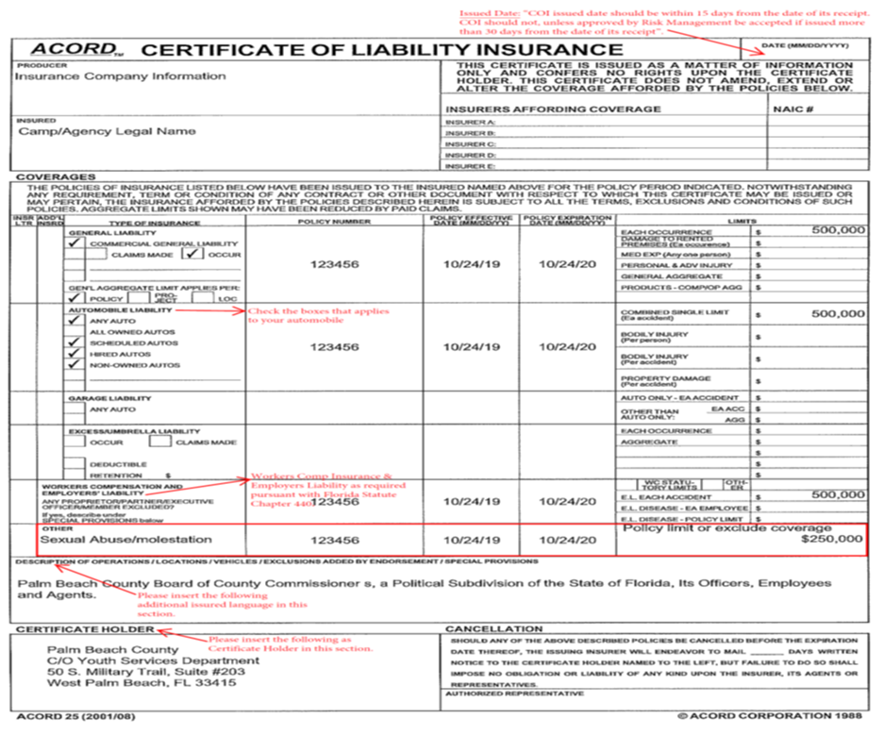
Certificate of Insurance (COI)
Notes:
Djenane

Slide 12
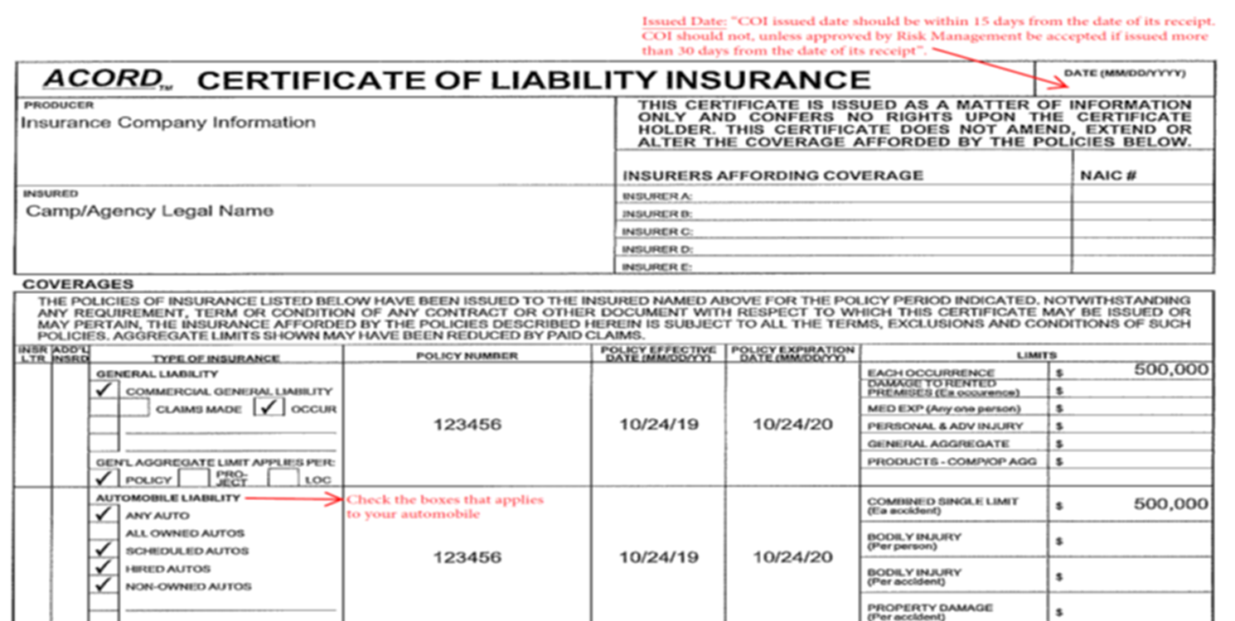
Certificate of Insurance (COI)
Notes:
JaVona

Slide 13
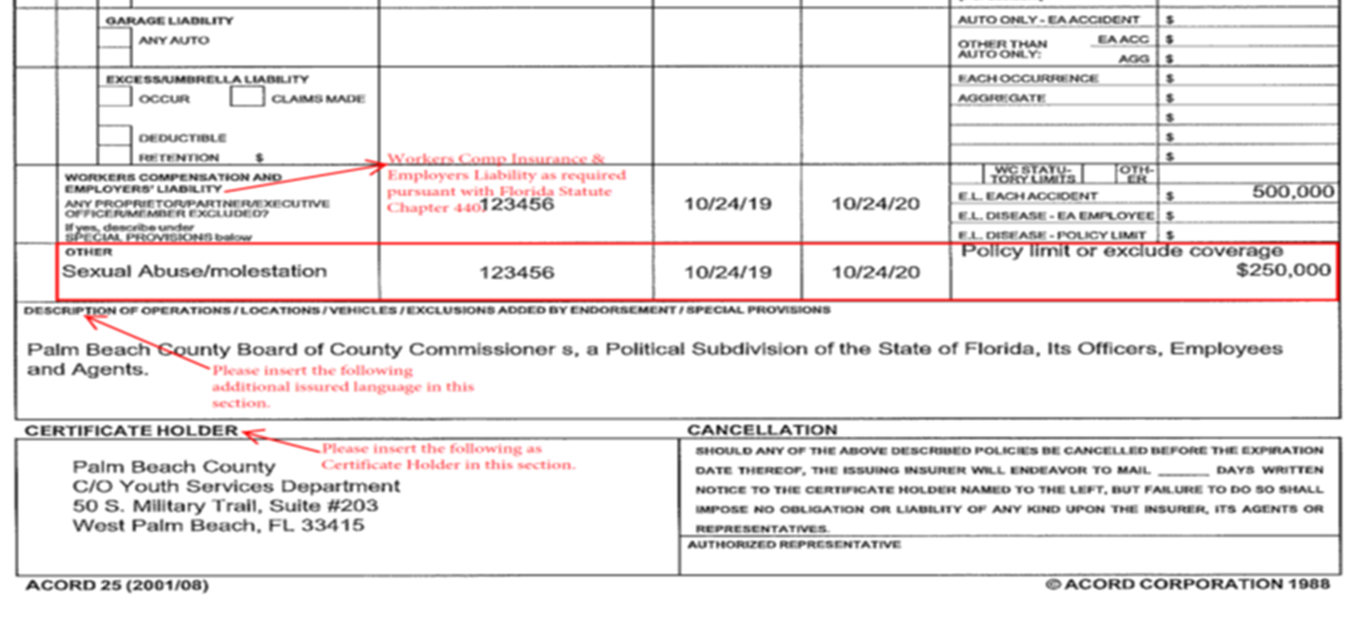
Certificate of Insurance (COI)
Notes:
JaVona

Slide 14
DCF Affidavit of Compliance
Notes:
Djenane to present
Must be completed for ALL staff that will be interacting with campers.
If you are a camp that does not hire employees until closer to camp; you need to complete the Affidavit with yourself or any employees you believe you will have that maybe you had last year.
It MUST be signed and notarized!
We will expect the updated version with all employees by April 17th.

Slide 15
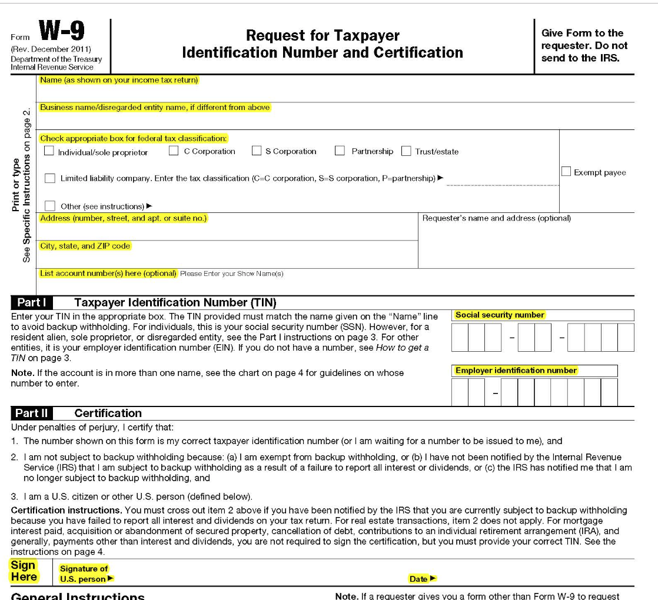

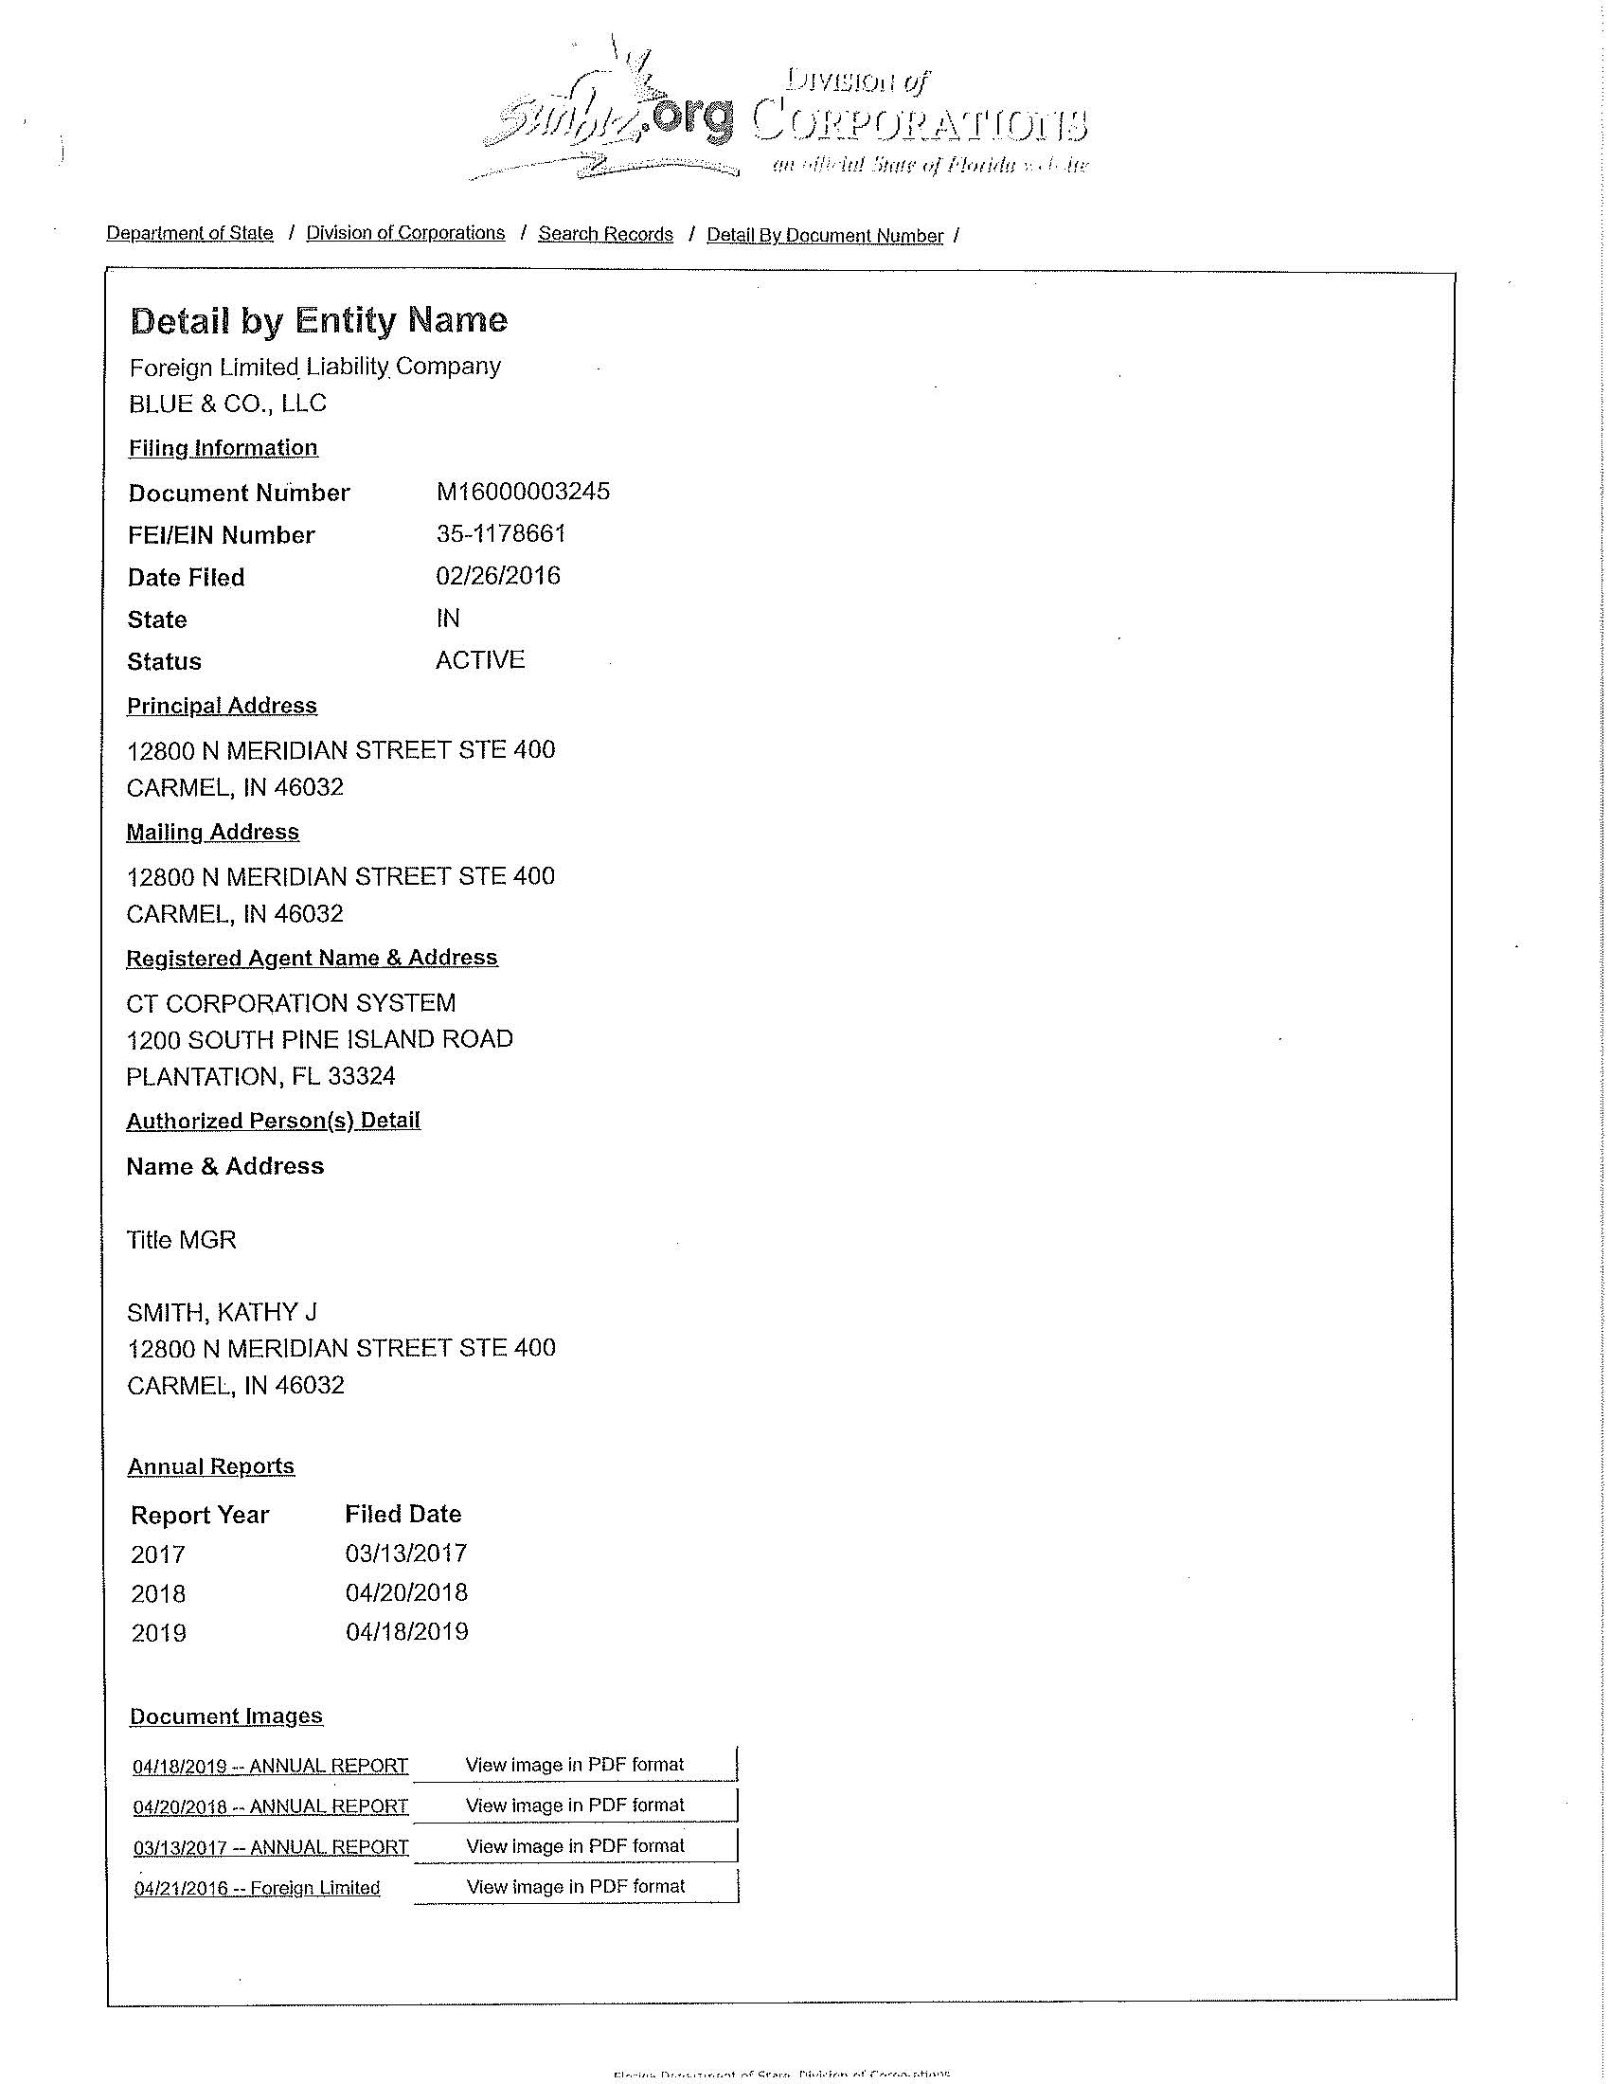
Sunbiz & W-9
Notes:
Markus to present
This is a sample of a Sunbiz business registration. An updated version should be attached yearly so we know it is current and active.
Also required to be updated annually is the W-9. The W-9 is valid for 1 year.
Also note, that the agency name listed on your w-9 and sunbiz registration must match the agency name you enter into the SCSP portal. (The exception to this would be our larger entities like the school district. We know that the school district has it’s own w-9 and it is will not match each school specifically. That’s ok).

Slide 16
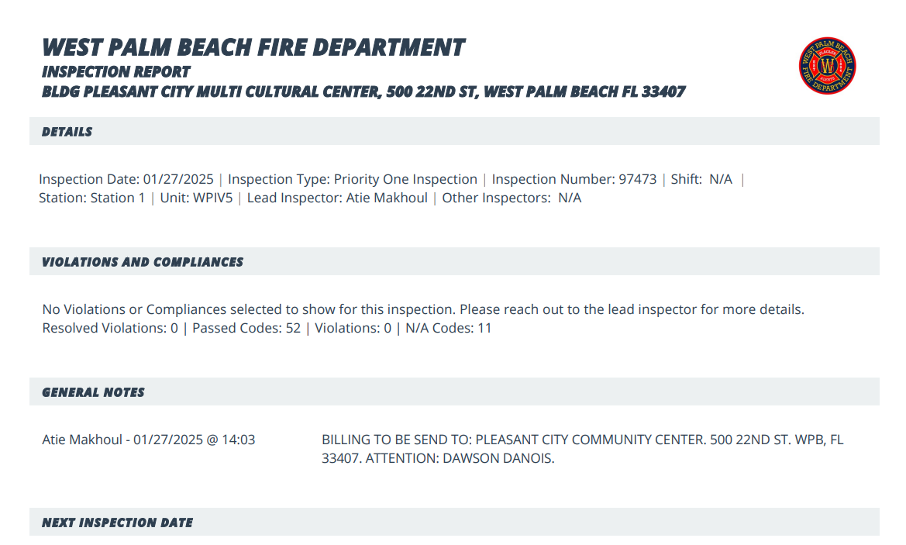
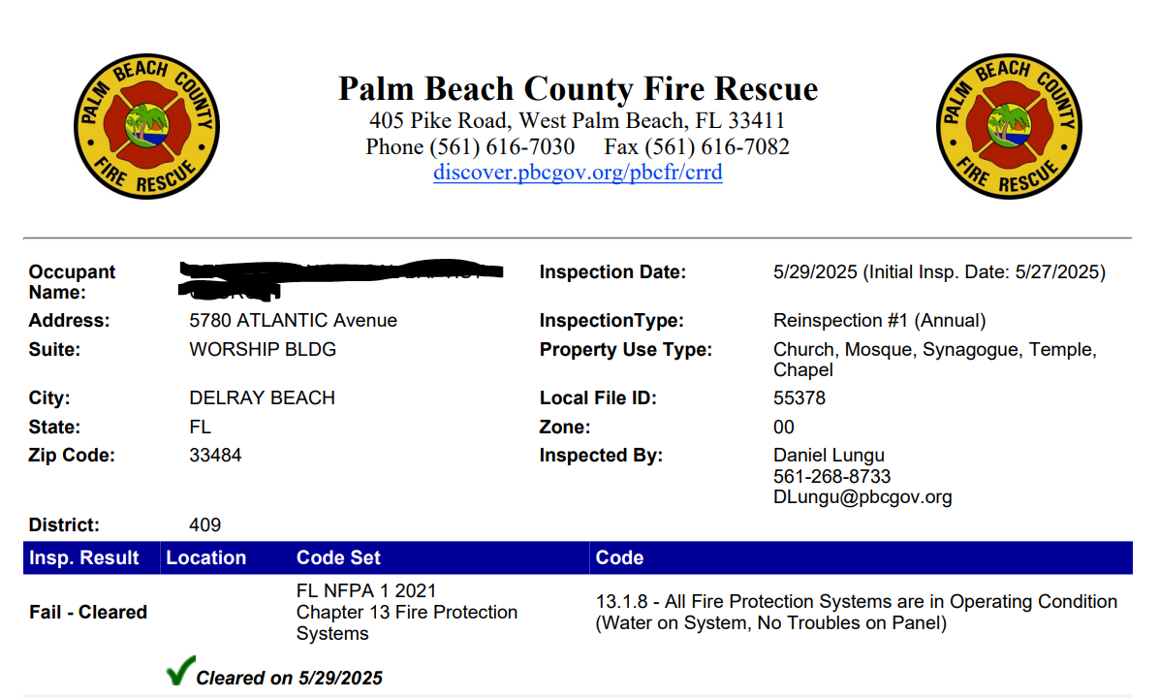
Fire Inspection
Notes:
Markus to present

Slide 17
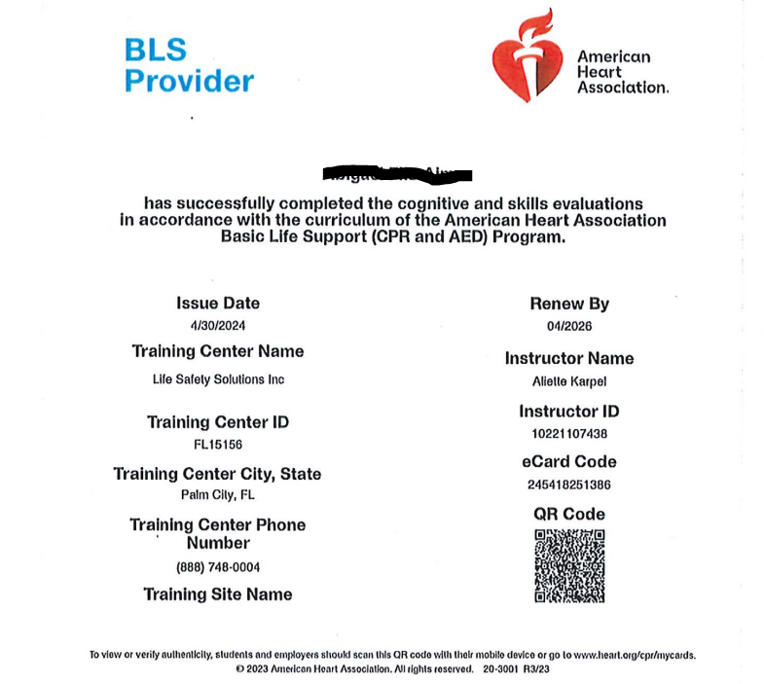
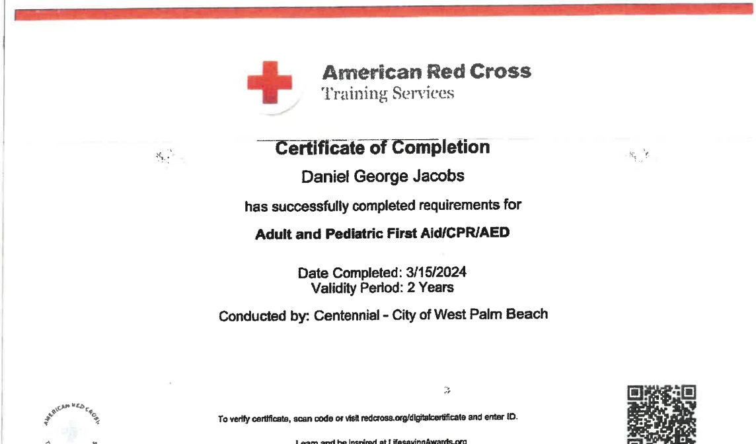
CPR Certificates
Notes:
Caleiyah to present

Slide 18
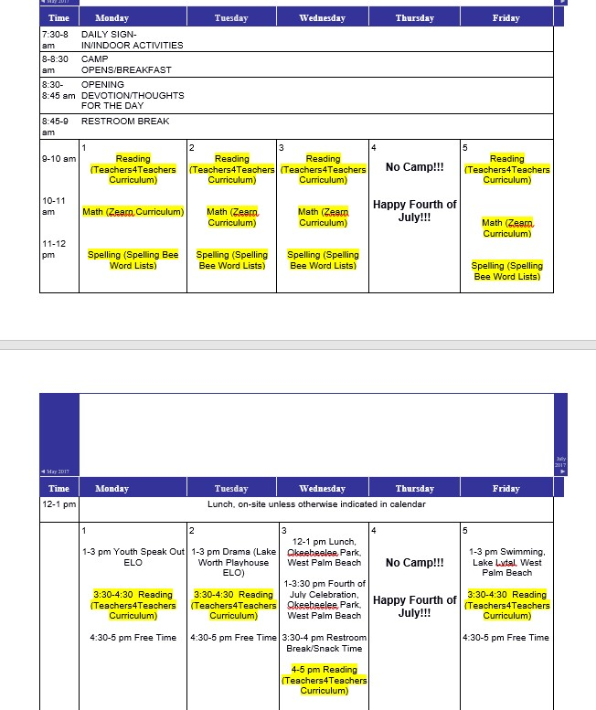
Daily Activity Schedule
Notes:
Caleiyah to present
This is a sample, providers can create their own or we will send the sample.
If you follow the same schedule week after week with differing field trips, you can provide us with one schedule and a dated field trip list.
If you don’t have your field trip list yet, you can give us a tentative list of trips; must be finalized before start of summer.
EEC Camps 4 Hours per day for Academics; Reg Camps 1 hour per day Academics PLEASE highlight on schedules (bold, different color, highlight) so easily identified
The deadline to update information will be April 4th.
Just a reminder If your camp is closing for vacation, please make sure your daily activity schedule reflects that.
If your camp is closing for vacation, please add to your daily activity schedule.
Keep in mind, if you do not operate, you will not receive reimbursement for that week(s).

Slide 19
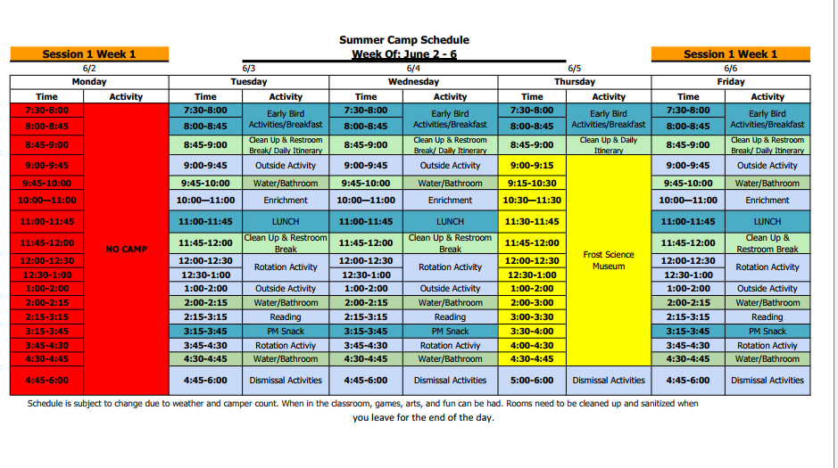
Daily Activity Schedule
Notes:
Caleiyah to present
This is a sample, providers can create their own or we will send the sample.
If you follow the same schedule week after week with differing field trips, you can provide us with one schedule and a dated field trip list.
If you don’t have your field trip list yet, you can give us a tentative list of trips; must be finalized before start of summer.
EEC Camps 4 Hours per day for Academics; Reg Camps 1 hour per day Academics PLEASE highlight on schedules (bold, different color, highlight) so easily identified
The deadline to update information will be April 4th.
Just a reminder If your camp is closing for vacation, please make sure your daily activity schedule reflects that.
If your camp is closing for vacation, please add to your daily activity schedule.
Keep in mind, if you do not operate, you will not receive reimbursement for that week(s).

Slide 20
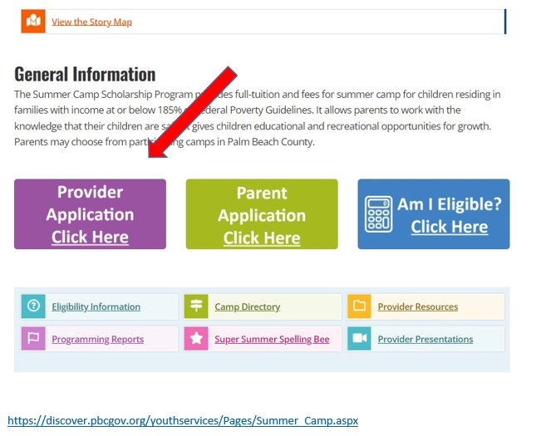
Provider Application
Notes:
JaVona to present
Next, I’d like to discuss the 2024 Provider Applications. To complete an application to be a provider with the SCSP, you will utilize the database/the portal which can be found on the YSD website.

Slide 21
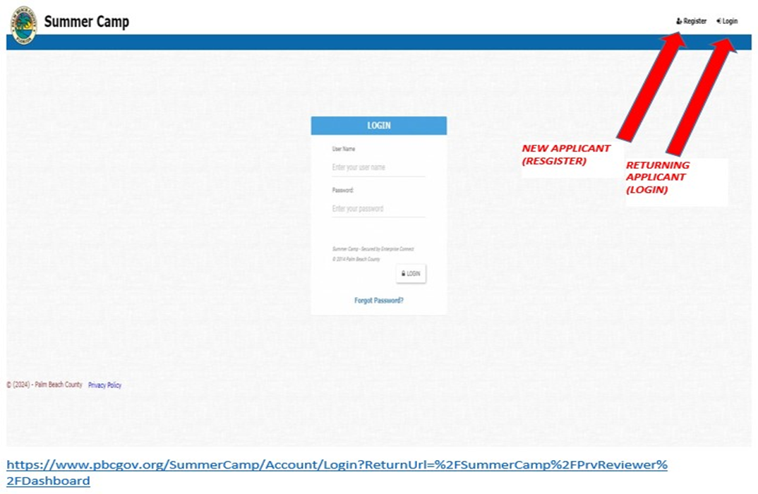
Provider Application
Notes:
JaVona to present
Next, I’d like to discuss the 2024 Provider Applications. To complete an application to be a provider with the SCSP, you will utilize the database/the portal which can be found on the YSD website.

Slide 22
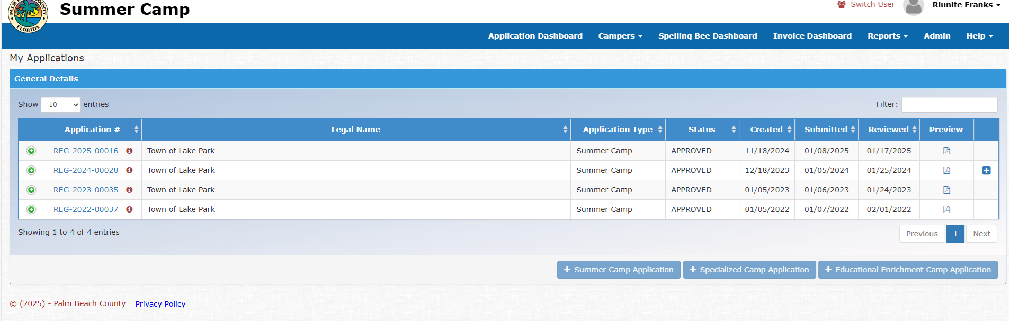
Choosing Application Type
Notes:
JaVona to present
Once you log in to the portal, you will see these options
Add new Summer Camp Application
Add new Specialized/Special Needs Camp Application
Add new EEC Application
If you are applying to be a Regular camp – you will select Add new summer camp application
For our sports, specialty, special needs – you will select add new specialized camp application
For our EEC sites – you will select EEC application
This is because when you get to the attachments section, you will be prompted for different items.

Slide 23
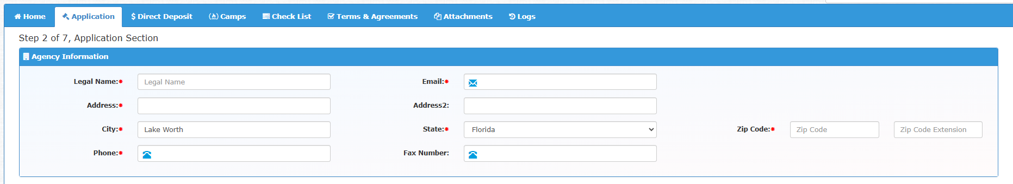
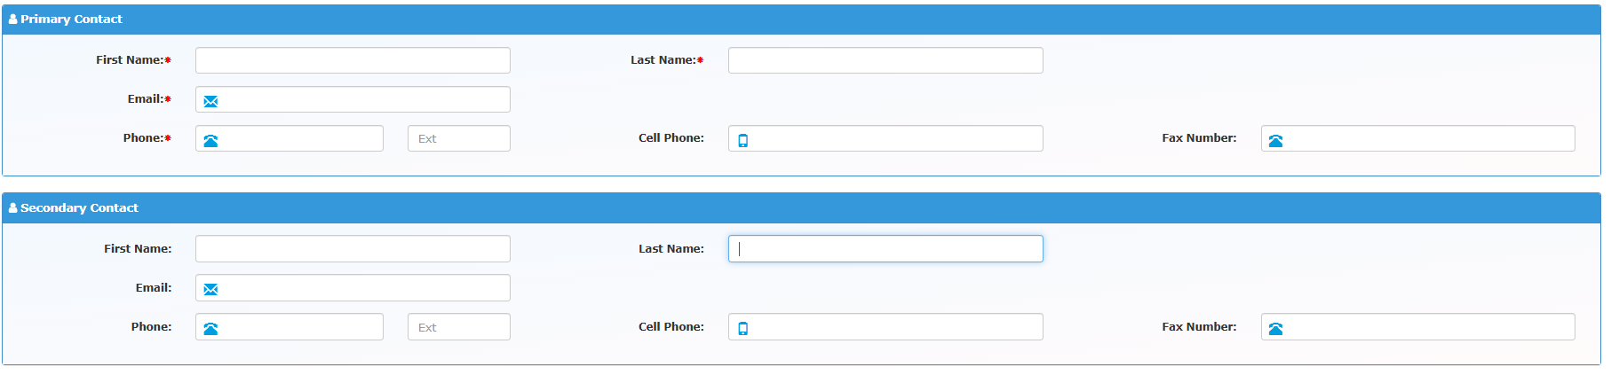
Provider Application
Notes:
JaVona to present

Slide 24
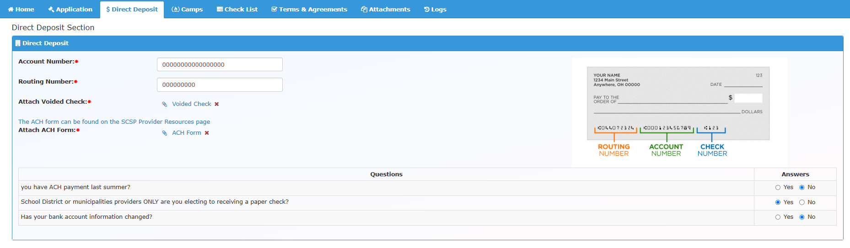
Direct Deposit
The application’s mailing address must match the vendor address on the ACH form
Routing #/ Account # must match EXACTLY on the ACH form and the voided check (including any 0s)
Notes:
Tamia

Slide 25
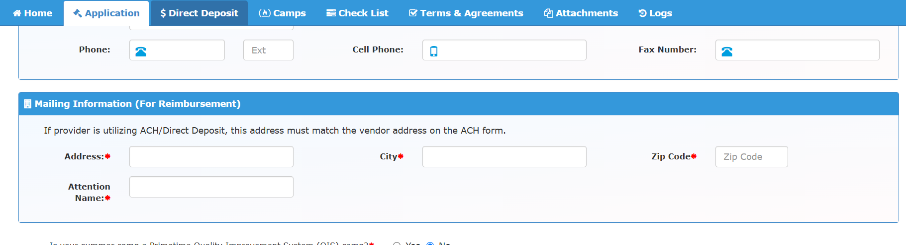

Direct Deposit
Notes:
Tamia to present
This is what the tab will look like as you’re completing your provider application. It will ask for your account number, routing number, and a voided check. You will be able to see this information and the accountant for our fiscal agent will be able to see the information but our staff (including myself and the Program Coordinator) cannot see this. So please double check your info as it goes in because we cannot assist you with any corrections. Also, you can only enter one bank account per provider not per camp. When you complete your application you list your multiple camps but they will all be subject to the same direct deposit account.

Slide 26
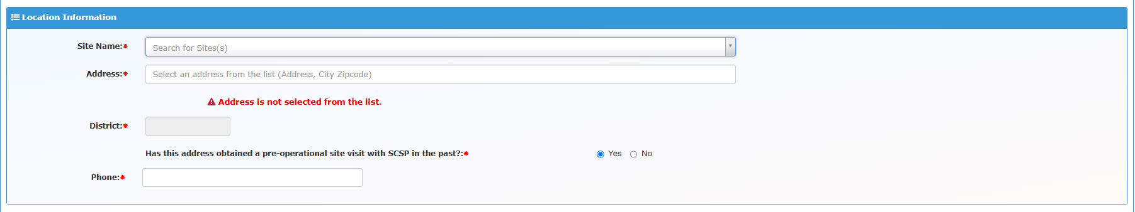
Provider Application
Notes:
JaVona

Slide 27
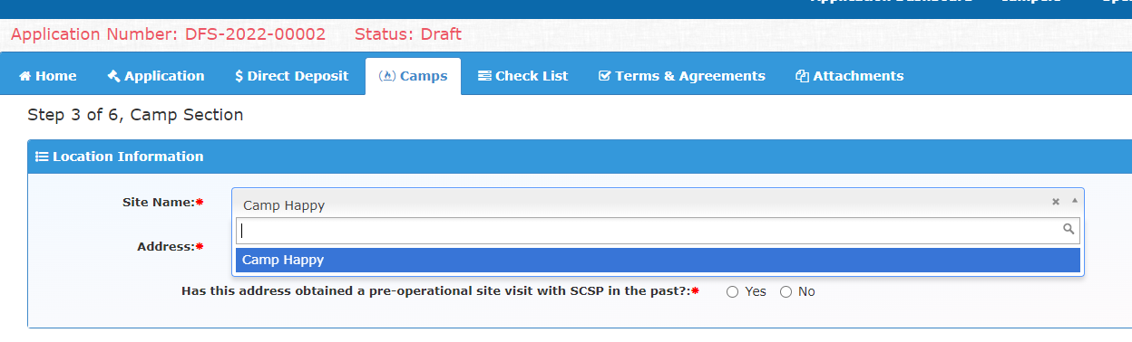
Database Updates
Notes:
JaVona to present
Has this address obtained a pre-operational site visit with SCSP in the past? Yes or No
If you have run your camp out of this exact location; you would select yes.
If this is a new camp location for your camp; you would select no.
This will allow us to run a report and see which camps require a pre-operational site visit.
All sites must have a pre-op visit before they are approved to receive our funding.

Slide 28

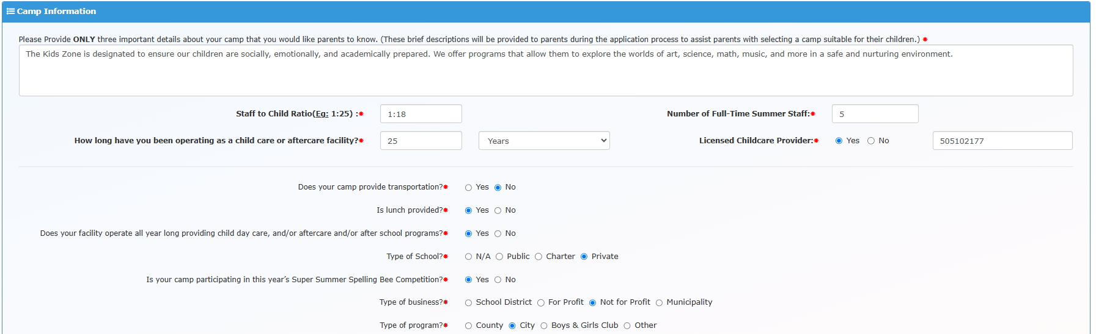
Database Updates
Is your summer camp or after-school program an ELC provider?
Notes:
JaVona to present
Has this address obtained a pre-operational site visit with SCSP in the past? Yes or No
If you have run your camp out of this exact location; you would select yes.
If this is a new camp location for your camp; you would select no.
This will allow us to run a report and see which camps require a pre-operational site visit.
All sites must have a pre-op visit before they are approved to receive our funding.

Slide 29
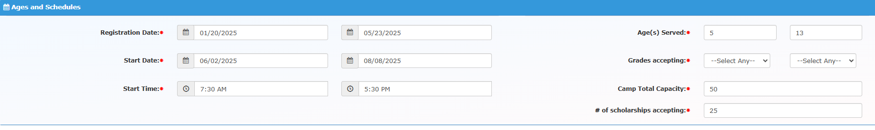
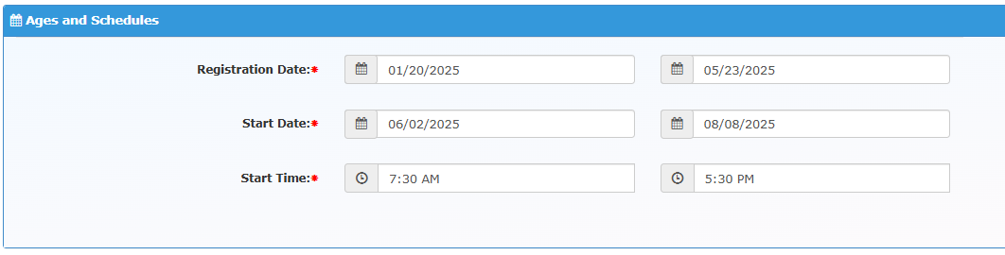
Database Updates
Notes:
JaVona to present
Has this address obtained a pre-operational site visit with SCSP in the past? Yes or No
If you have run your camp out of this exact location; you would select yes.
If this is a new camp location for your camp; you would select no.
This will allow us to run a report and see which camps require a pre-operational site visit.
All sites must have a pre-op visit before they are approved to receive our funding.

Slide 30
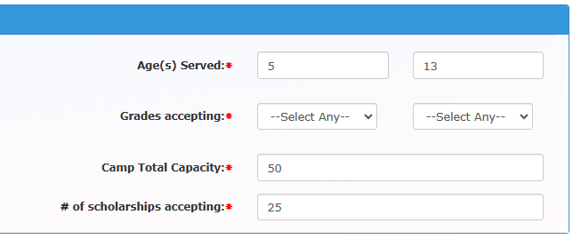
Database Updates
Notes:
JaVona to present

Slide 31
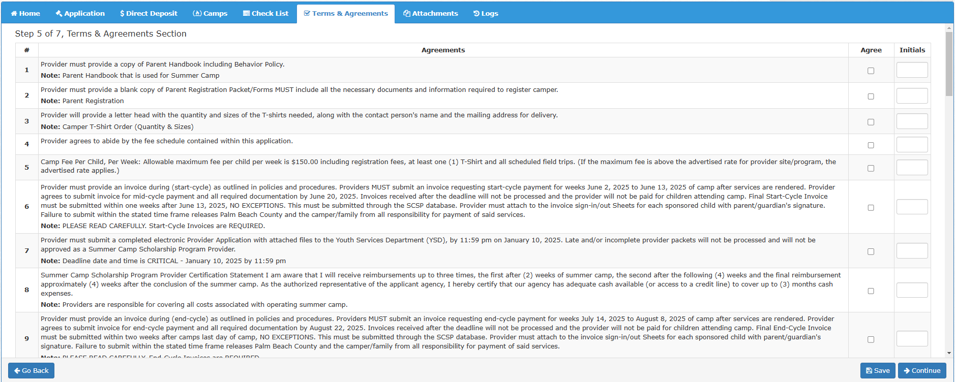
Terms & Agreements

Slide 32
Provider Application Status
^{Submitted}
^{YSD received your application.}
^{Returned}
YSD reviewed application and items are missing, incomplete or invalid.
^{Resubmitted}
Provider corrected items and resubmitted application to YSD.
^{Preliminary Approval}
Provider has incomplete items in application, but YSD has confirmed required documents. Updated items needed no later than April 10th
^{Approved}
All provider documents are valid, some documents may expire during summer, provider is responsible of getting updated documents to YSD within 48hrs of expiration.
^{Denied}
Provider does not meet the criteria for our program or chooses not to participate this summer.

Slide 33
Reimbursement Guidelines
Camp must be offered 5 days a week to request reimbursement (only exceptions being County-observed holidays or natural disasters)
June 19th - Juneteenth
July 4th – Independence Day
(Please note if you are closed any day that is not approved you will forfeit weekly reimbursement)
Camps must provide a minimum of 9 hours of supervised activities daily (excluding before/aftercare)
Camper must attend camp a minimum of 3 days for 4 consecutive hours daily for provider to request reimbursement.
Notes:
Wen

Slide 34
Reimbursement Guidelines
Providers are not allowed to substitute a child, accept child or reassign scholarship number to another child without prior YSD Approval.
Approved providers are not eligible to receive scholarships for their own children.
Reimbursement rates:
$150 weekly for Regular & Specialty Camps
$170 weekly for Educational Enrichment Camps
$350 weekly for Special Needs Camps
Notes:
Wen

Slide 35
Reimbursement Guidelines
1 week excused absence
Completed form MUST be uploaded into the portal and noted on the attendance sheet
Providers must email list of campers that haven’t registered for camp by Friday, May 8, 2026
Attendance sheets must be signed by a parent and a camp staff (every page) – if electronic, only parent signature required
Check Rosters Weekly, campers assignment may change!
We recommend using sign-in/out sheets from portal (they are accurate)

Slide 36
Reimbursement Guidelines
MANDATORY
START-CYCLE BILLING
JUNE 1ST – JUNE 12TH
DUE DATE: JUNE 19, 2026 (Holiday)
Have in by 6/1
MID-CYCLE BILLING
JUNE 15TH – JULY 10TH
DUE DATE: JULY 24, 2026
END-CYCLE
BILLING
July 13TH – August 7TH
DUE DATE: AUGUST 21, 2026
Notes:
Again very important dates to keep in mind for reimbursement and invoice submission
Invoices are MANDATORY, missing deadlines may result in reduce or non-payment

Slide 37
Dates to Remember
Summer Camp Dates: June 1st 2026 – August 7th 2026
Provider Application Dates: Open: 12/1/2025 Close: 01/09/2026
Mandatory Provider Meeting: In-Person, January 29, 2026
Parent Application Dates: Open: 2/9/2026 Close: 4/3/2026
11th Annual Super Summer Spelling Bee: July 9th 2026
Invoicing
Billing Cycles: (Failure to meet deadline date may result in non-payment)
Start-Cycle: 6/1/2026 – 6/12/2026 (2 Weeks) Last day to submit: 6/19/2026
Mid-cycle: 6/15/2026 – 7/10/2026 (4 Weeks) Last day to submit: 7/24/2026
End Cycle: 7/13/2026 – 8/7/2026 (4 Weeks) Last day to submit: 8/21/2026
Notes:
JaVona

Slide 38
Monitoring
Pre-Operational Site Visits
Portal Monitoring
Desk Monitoring to begin by April 2026
Required documentation was due by April 10, 2026
Any camp with outstanding documentation are subject to being removed from program
Send all outstanding documentation to YSD immediately
On-Site Monitoring will start in June 2026
On-Site monitoring will be scheduled based on Daily Schedule.
*Camps are responsible to ensure compliance with all laws and regulations pertaining to summer camps
Notes:
JaVona

Slide 39
Provider Presentation
Virtually meeting with YSD staff
15-20 minute presentation
Will be shared on website to share with families
To be scheduled after approved application
Provider should paint a full picture of camp for funders and marketing
9 Areas of Review:
Activities - Opportunities for development of skills rather than just recreation or having fun
Staff Growth & Development – Training and development options for staff
Campers (building character) - Providing activities & opportunities for emotional & personal growth
Facility/ Location
Managing Conflict - Procedure/plan in place to manage a conflict
Marketing - Informing the neighboring community about your services
Nutritious Meals
Preventing Summer Slide - the loss of academic skills & knowledge over the course of summer vacation
Safety & Sanitation - to ensure staff & campers are practicing appropriate safety measures
Notes:
JaVona to present
We met with every camp provider to gain more information about the camp to provide to our funders and families.
If your camp is new or if it required follow-up you will be required to present again. If you received supportive resources, we MAY meet with you to see how those were implemented.
Best Practices – remembering that education and character building can be integrated into recreational activities.
Areas of Growth - Some of the areas of growth included additional training opportunities for camp staff (these camp are being linked with Prime Time to see if they could qualify for services) and Preventing the Summer Slide. Ultimately, we would like to see each of our camps offer an minimum of one-hour of educational curriculum daily.
33 camps didn’t open after their application was approved and 6 never submitted invoices – often this is due to low to no camp enrollment. With marketing, camps that take a multifaceted approach have higher numbers (engaging families in the off-season, utilizing emails, texts, newsletters, and social media; calling previous families to remind them that summer camp registration is coming up.) Camps with the highest numbers also provide outreach days or open houses. This allows parents to come to their camp or a public location and utilize their computers and printers. Camp staff is familiar with the Summer Camp website and assists with the application. These applications get returned less often and are easier for our staff members to review.

Slide 40

Provider Presentation
All received presentations can be found on our website:
https://discover.pbcgov.org/youthservices/Pages/Camp-Provider-Presentations.aspx
Notes:
JaVona to present
https://discover.pbcgov.org/youthservices/Pages/Camp-Provider-Presentations.aspx
After completing the presentation meeting, camps provided their actual presentation (video or ppt) and it has been added to our Summer Camp portal. Parents are able to access the presentations to get a full picture of what a camp has to offer.
Camps that were with us last year and are approved again for 2024, can choose to use the same presentation video. If you’d like to update it, you’ll need to send us an updated video.

Slide 41
Provider Responsibilities
Complete and submit the provider application with appropriate documents by 1/9/2026
Marketing and recruiting for enrollment
Provider Presentations for YSD website, submit to Program Coordinator by 1/9/2026
Parent application assistance and/or guidance to obtain assistance from YSD
Available for Parent Registration no later than 3/16/2026
Email list of campers to Program Coordinator who have not completed registration by 5/1/2026
Billing – comply with the policy for reimbursement (upload attendance logs, absence notes, summer school status)
Compliance with programming, change notification, communication with YSD, etc.
*Camps are responsible to ensure compliance with all laws and regulations pertaining to summer camps
Notes:
JaVona

Slide 42

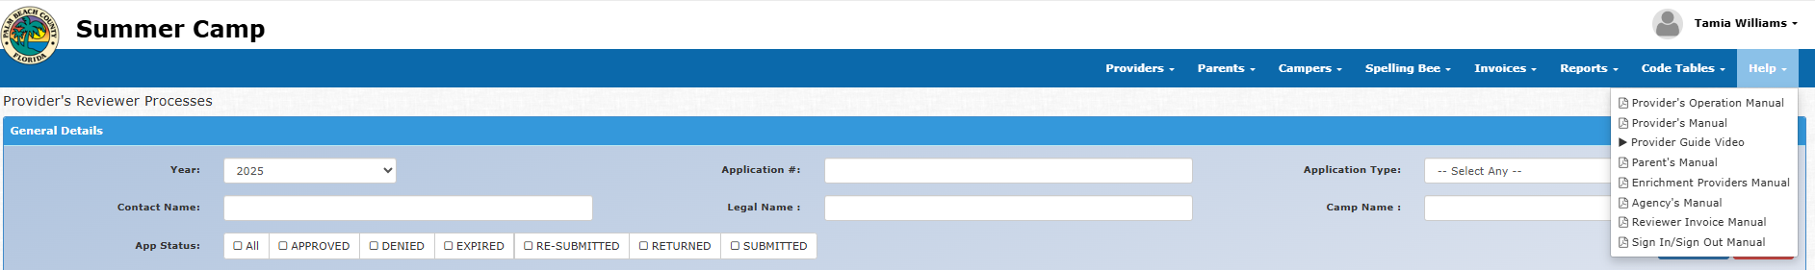
Portal Support
Provider Guide Video will walk you through entire application process
PBCGOV Video Player

Slide 43

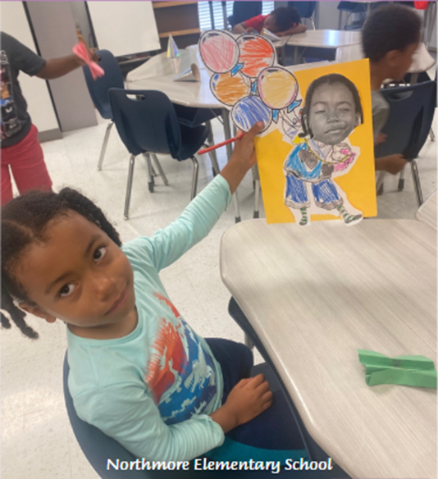

Questions

Slide 44
Contact Us
Djenane Saintyl
Program Coordinator
Office: (561) 242-5738 Email: DSaintyl@pbc.gov
Markus Lockhart
Program Coordinator
Office: (561) 242-5710 Email: MLockhart@pbc.gov
JaVona Wilson
Senior Program Specialist
Office: (561)242-5705 Cell: (561) 312-3203
Email: JWilson@pbc.gov
Youth Services Department
Outreach & Community Programming Division
50 S. Military Trail, Suite 203
West Palm Beach, FL 33415
Main Phone: (561) 242-5713
Website http://www.discover.pbcgov.com/youthservices

Slide 45

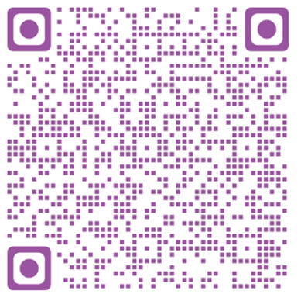

Connect with YSD

Slide 46




Thank You Supporters

