Slide 1



Palm Beach County
Impact Fee Update Study
April 1, 2022

Slide 2
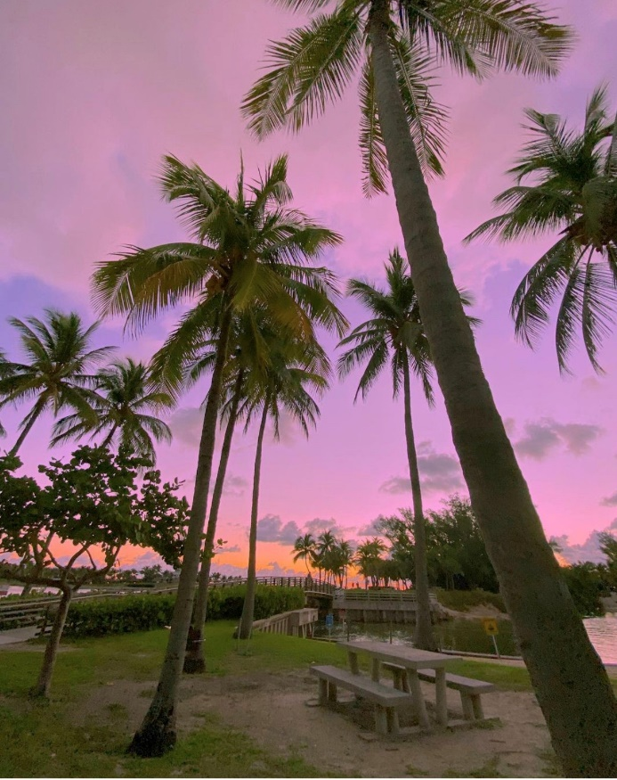
Presentation Overview
Background/Purpose
Technical Study
Public Buildings
Fire Rescue
Law Enforcement
Library Facilities
Parks & Recreation Facilities
School Facilities
Transportation
Next Steps

Slide 3
Background/Purpose
Palm Beach County:
3rd largest county in population out of 67 counties (1.5 million)
32nd in terms of population growth rate (0.8 percent per year through 2045)
5th in terms of absolute population growth
Projected to add 250,000 residents through 2045
10th in terms of residential permitting levels
Implemented impact fees in 1988
Last updated in 2014-2018
Most fees remained at 2012-study levels

Slide 4
Background/Purpose
Study focus area:
Public Buildings
Fire Rescue
Law Enforcement
Library Facilities
Parks and Recreation Facilities
School Facilities
Transportation

Slide 5
Background/Purpose
Impact Fee Definition:
One-time capital charge to new development
Covers the cost of new capital facility capacity
Implements the CIE and CIP

Slide 6
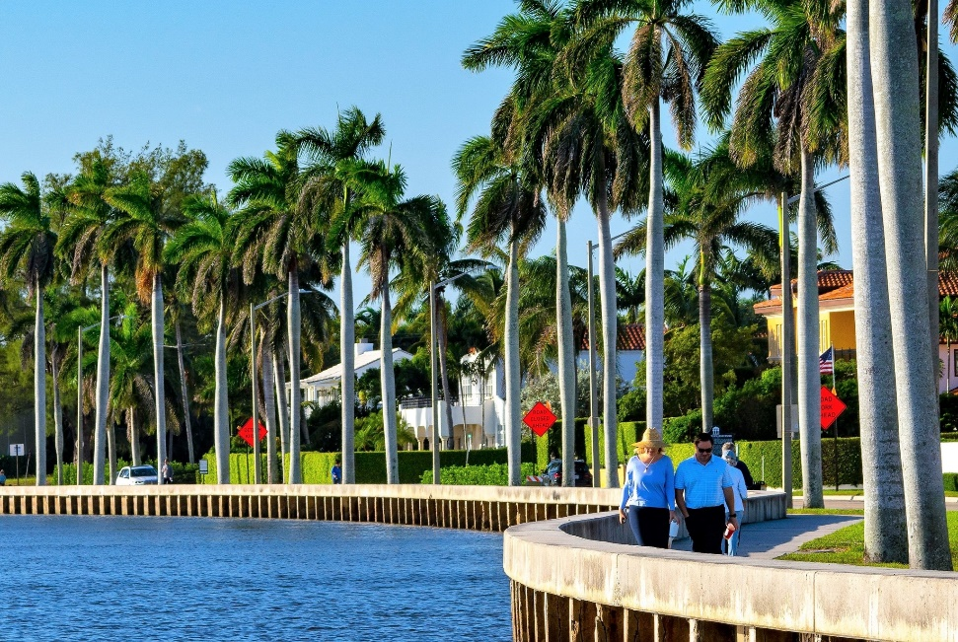
Background/Purpose
Why Impact Fees?
Maintain current level-of-service (LOS)
Calculate the cost of growth
Potential large developments
Most needed when:
High growth
Limited funding

Slide 7
Background/Purpose
Consumption-Based Methodology:
Common methodology used by many Florida jurisdictions
Charges new growth based on its consumption of capacity
Fees are calculated at a rate that cannot correct existing deficiencies
BOCC can adopt fees at a reduced rate
Study uses the methodology approved by the Impact Fee Review Committee in 2019

Slide 8
Background/Purpose
Legal Requirements – F.S. 163.31801:
Most recent and localized data
Minimum of 90-day notice for any fee increases after adoption
May not collect prior to building permit
Rational nexus in the amount of collection and expenditures
May not use for prior debt or projects unless there is a nexus showing use for need due to new growth
In any action challenging the fee, the government has the burden of proof
Accounting of impact fee collections & expenditures

Slide 9
Background/Purpose
HB 337 in 2021:
Limit on fee increases:
No more than 12.5% per year
Cannot be increased more than 50%
Cannot be increased more than once every four years
Exception:
A study within the past 12 months demonstrating extraordinary circumstances
Two public workshops to discuss the extraordinary circumstances
Increase to be approved by 2/3rd of the governing body

Slide 10
Background/Purpose
Basic Impact Fee Formula:
Net Impact Fee =
(Cost – Credit) x Demand
Cost to add capacity
Non-impact fee revenue from future development
Population/
Miles of Travel

Slide 11
Background/Purpose
Summary of Calculated Impact Fee Rates:
Land Use | Unit | Public Buildings | Fire Rescue | Law Enforcement | Library Facilities | Parks & Recreation | School Facilities | Transportation | Total Calculated | Total Adopted
Residential
Single Family (2,000 sf) | du | $1,573 | $852 | $230 | $311 | $2,967 | $8,322 | $5,892 | $20,147 | $13,055
Non-Residential
Light Industrial | 1,000 sf | $466 | $193 | $59 |  |  | - | $2,633 | $3,351 | $1,683
Office (50,000 sf) | 1,000 sf | $951 | $114 | $120 |  |  | - | $5,847 | $7,032 | $3,609
Retail (125,000 sfgla) | 1,000 sfgla | $2,503 | $235 | $315 |  |  | - | $8,323 | $11,376 | $8,170

Slide 12
Background/Purpose
Summary of Maximum Allowable Impact Fee Rates:
Land Use | Unit | Public Buildings | Fire Rescue | Law Enforcement | Library Facilities | Parks & Recreation | School Facilities | Transportation | Total Maximum Allowable* | Total Adopted
Residential
Single Family (2,000 sf) | du | $334 | $414 | $192 | $311 | $1,290 | $8,322 | $5,892 | $16,755 | $13,055
Non-Residential
Light Industrial | 1,000 sf | $110 | $120 | $11 |  |  | - | $2,284 | $2,525 | $1,683
Office (50,000 sf) | 1,000 sf | $196 | $75 | $15 |  |  | - | $5,127 | $5,413 | $3,609
Retail (125,000 sfgla) | 1,000 sfgla | $504 | $182 | $86 |  |  | - | $8,323 | $9,095 | $8,170
*Over the next four years

Slide 13
Presentation Overview
Background/Purpose
Technical Study
Public Buildings
Fire Rescue
Law Enforcement
Library Facilities
Parks & Recreation Facilities
School Facilities
Transportation
Next Steps

Slide 14
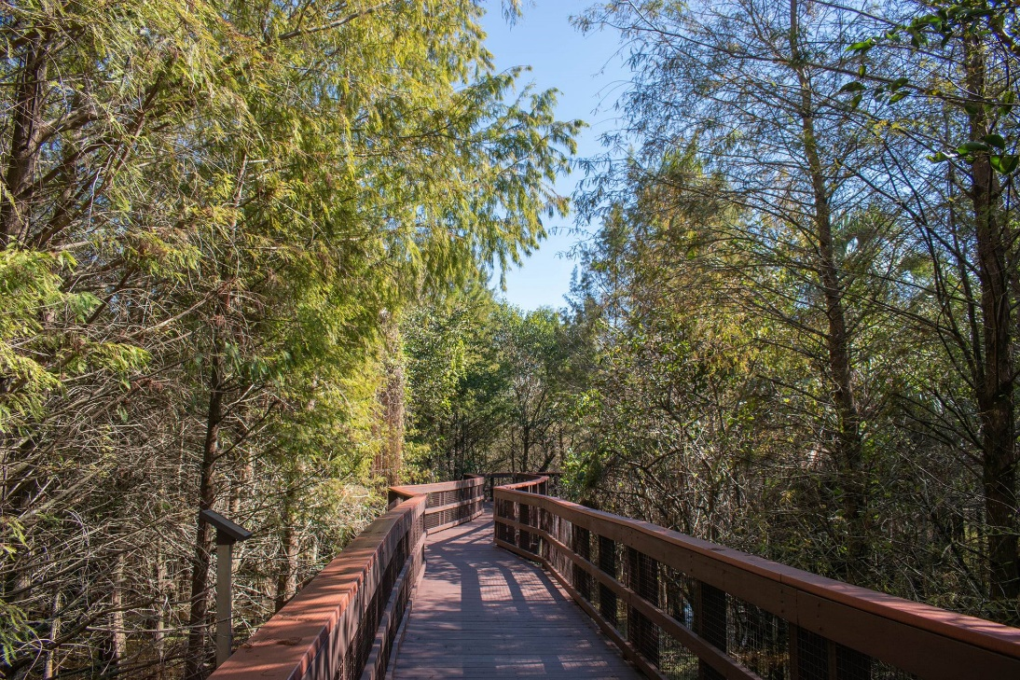
Technical Study
Impact Fee Components
Inventory
Level of Service
Cost Component
Credit Component
Net Impact Cost
Calculated Fee
Fee Comparison

Slide 15
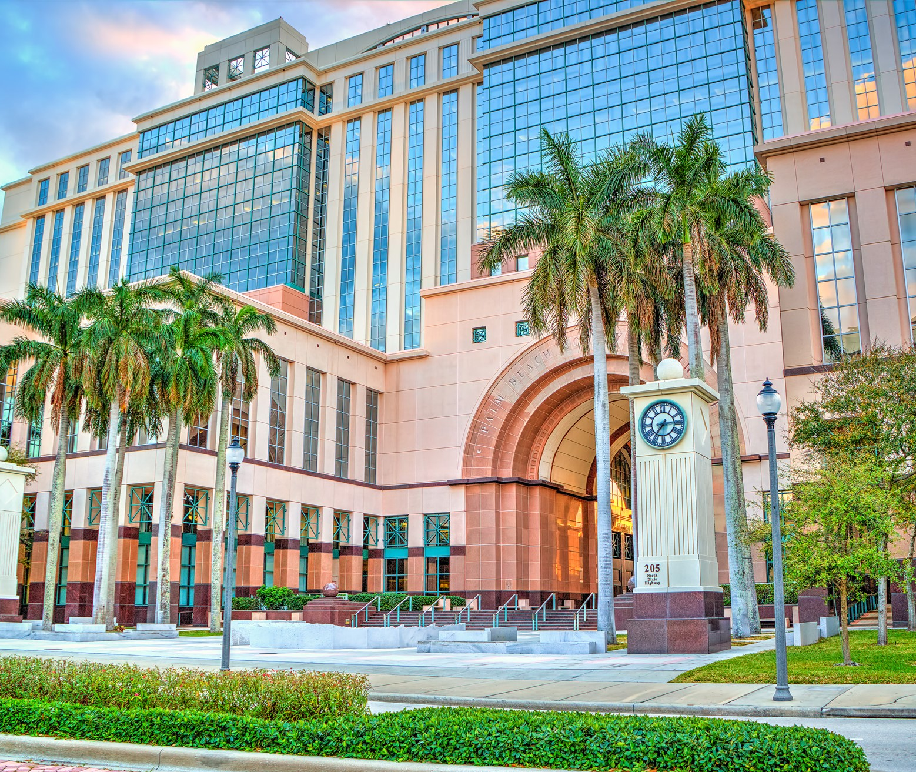
Public Buildings

Slide 16
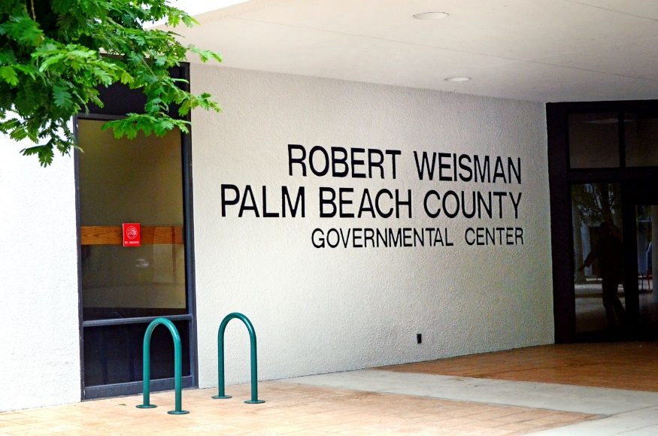
Public Buildings
Inventory
General Government Buildings
≈6.5 M total square feet
Office & administrative: 2.1 M sf
Courthouse: 954,000 sf
Jail: 1.3 M sf
Industrial: 464,000 sf
Industrial support: 1.7 M sf
≈620 acres of land
Unit Costs:
Buildings: $248 per square foot (range from $55 per sf to $400 per sf)
Land: $200,000 per acre

Slide 17
Public Buildings
Level of Service
Service Area: Countywide
Variable | Weighted Population | Functional Population
Population (Countywide) | 1,598,324 | 1,567,886
Public Buildings Square Footage (Primary Bldgs) | 4,776,573 | 4,776,573
Achieved LOS (Square Feet per Resident) | 2.99 | 3.05

Slide 18
Public Buildings
Cost Component
Variable | Public Buildings | % of Total
Building Value | $1.639 B | 93%
Land Value | $0.124 B | 7%
Total Asset Value | ≈$1.763 B | 100%
Service Area Population | 1,567,886 | -
Total Impact Cost per Functional Resident | ≈$1,126 | -

Slide 19
Public Buildings
Credit Component: Cash Credit
Variable | Total FY 2015-2020
Ad Valorem | $3,720,000
Sales Tax | $34,796,540
Grants/Other | $8,425,000
 | $46,941,540
Average Annual Capital Expansion Expenditures | $7,823,590
Average Annual Functional Population | 1,505,368
Capital Expansion Expenditures per Functional Resident | $5.20
Portion Funded with Ad Valorem Tax Revenues | $0.42
Residential Land Uses Credit Adjustment Factor | 1.70
Residential Land Uses: Adjusted Capital Expansion Expenditures per Resident | $0.71
Portion Funded with Other Revenue Sources | $4.78
Residential Land Uses: Total Capital Expansion Credit per Resident | $5.49

Slide 20
Public Buildings
Credit Component: Debt Service
Description | Funding Source | # of Remaining Payments | PV of Remaining Payments | Avg Annual Functional Population | Credit per Functional Resident
Refunding Bonds, Series 2012 | Non-Ad Valorem | 6 | $6.9 M | 1,629,179 | $4.20
Public Improvement Rev Refunding Bonds, Series 2015 | Non-Ad Valorem | 15 | $46.8 M | 1,694,872 | $27.60
Public Improvement Revenue Bonds, Series 2021A | Non-Ad Valorem | 19 | $46.8 M | 1,719,543 | $27.20
Total Debt Service Credit per Functional Resident |  |  |  |  | $59.00

Slide 21
Public Buildings
Credit Component: Total Credit
Variable | Credit
Cash Credit
Annual Capital Improvement Credit per Functional Resident
- Residential Land Uses | $5.49
- Non-Residential Land Uses | $5.20
Capitalization Rate | 2.4%
Capitalization Period (in years) | 25
Total Capital Improvement Credit per Functional Resident
- Residential Land Uses | $102.32
- Non-Residential Land Uses | $96.91
Debt Service
Debt Service Credit per Functional Resident | $59.00
Total Credit
Total Credit per Functional Resident
- Residential Land Uses | $161.32
- Non-Residential Land Uses | $155.91

Slide 22
Public Buildings
Net Impact Cost
Variable | Cost/Credit
Impact Cost
Total Impact Cost | $1,126
Revenue Credit
Total Credit per Functional Resident
- Residential Land Uses | $161
- Non-Residential Land Uses | $156
Net Impact Cost
Net Impact Cost per Functional Resident
- Residential Land Uses | $965
- Non-Residential Land Uses | $970

Slide 23
Public Buildings
Calculated Impact Fee
Land Use | Unit | Functional Residents Per Unit | Fully Calculated Fee | Current Adopted Fee (2012)* | Maximum Allowable Fee**
Residential
801 to 1,399 sf | du | 1.31 | $1,264 | $171 | $256
2,000 to 3,599 sf | du | 1.63 | $1,573 | $223 | $334
Non-Residential
Light Industrial | 1,000 sf | 0.48 | $466 | $74 | $111
Office | 1,000 sf | 0.98 | $951 | $131 | $196
Retail/Shopping Center (40K-150K sfgla) | 1,000 sfgla | 2.58 | $2,503 | $336 | $504
* Based on 2012 study, adopted at 27%
** Over the next four years

Slide 24
Public Buildings
Impact Fee Component Changes since 2014-18 Study:
Input Variable | 2014-18 Study (Not Adopted) | 2021 Study | % Change
Residential 2,000 – 3,599 sf (per du)
Total Impact Cost per Functional Resident | $1,014 | $1,126 | +11%
Total Credit per Functional Resident | $197 | $161 | -18%
Net Impact Cost per Functional Resident | $817 | $965 | +11%
Functional Residents per Unit | 1.56 | 1.63 | +4%
Calculated Impact Fee | ≈$1,275 | $1,573 | +23%

Slide 25
Public Buildings
Impact Fee Comparison
Land Use | Unit | Palm Beach County |  |  | Collier County | Martin County | St. Lucie County
Land Use | Unit | Current Adopted | Fully Calculated | Maximum Allowable* | Collier County | Martin County * | St. Lucie County
Study Date | - | 2012 | 2021 | N/A | 2016 | 2012 | 2017
Assessed Portion | - | 27% | N/A | N/A | 100% | 100% | 100%
Residential
Single Family (2,000 sf) | du | $223 | $1,573 | $334 | $934 | $646 | $365
Multi-Family (1,300 sf) | du | $171 | $1,264 | $256 | $444 | $646 | $327
Non-Residential
Light Industrial | 1,000 sf | $74 | $466 | $111 | $359 | $182 | $74
Office | 1,000 sf | $131 | $951 | $196 | $620 | $316 | $323
Retail/Shopping Center (40,000 to 150,000 sfgla) | 1,000 sfgla | $336 | $2,503 | $504 | $1,275 | $551 | $547
*Over the next four years

Slide 26
Public Buildings
Revenue Projections
Based on permitting levels from 2015+
Full calculated rates ≈$10.0 million per year
Max allowable rates ≈$2.1 million per year
Examples of projects eligible for impact fee funding
PBSO Shooting Range Expansion (≈$9.5 M)
Airport Center Building 3 (≈$68 M)
Atlantic Commons Civic Site (≈$10 M)
Main Courthouse Expansion/Annex (≈$135 M the first phase)

Slide 27
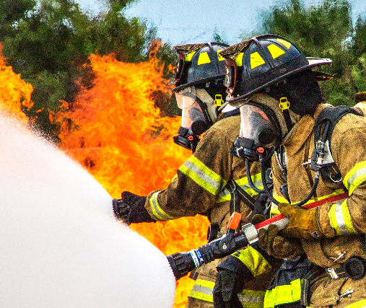
Fire Rescue

Slide 28
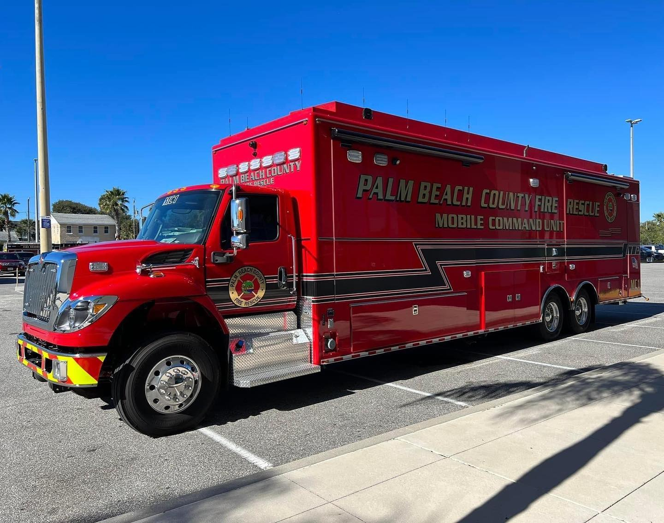
Fire Rescue
Inventory
43 Fire Rescue Stations
≈387,000 sf (fire rescue)
≈200 acres of land
Vehicles/equipment
Unit Costs:
Land: $325,000 per acre
Buildings: $525 per square foot

Slide 29
Fire Rescue
Level of Service
Service Area: Unincorporated County & 19 Cities
Variable | Figure
Number of Stations | 43
Total Number of Incidents (2020) | 114,642
LOS (Incidents per Station) | 2,666

Slide 30
Fire Rescue
Cost Component
Variable | Fire Rescue | % of Total
Building Value | $203.2 M | 55%
Land Value | $36.8 M | 10%
Vehicle & Equipment Value | $130.0 M | 35%
Total Asset Value | ≈$370.0 M | 100%
Number of Incidents | 114,642 | -
Total Impact Cost per Incident | ≈$3,227 | -

Slide 31
Fire Rescue
Credit Component: Annual Cash Credit
Variable | Total FY 2017-2021
Ad Valorem Funding | $3,212,665
Average Annual Capital Expansion Expenditures | $642,533
Average Annual Incidents | 114,946
Capital Expansion Expenditures per Incident | $5.59
Residential Land Uses Credit Adjustment Factor | 1.70
Residential Land Uses: Adjusted Capital Expansion Expenditures per Incident | $9.50

Slide 32
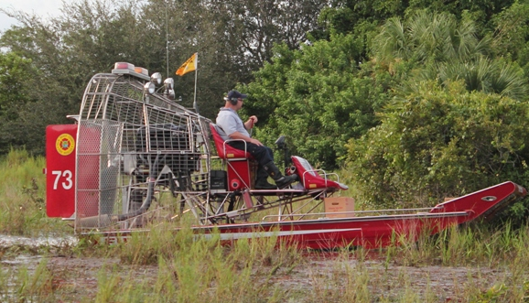
Fire Rescue
Credit Component: Total Credit
Variable | Credit
Revenue Credit
Cash Credit per Incident
- Residential Land Uses | $9.50
- Non-residential Land Uses | $5.59
Capitalization Rate | 2.4%
Capitalization Period (in years) | 25
Total Credit
Total Capital Improvement Credit per Incident
- Residential Land Uses | $177.05
- Non-residential Land Uses | $104.18

Slide 33
Fire Rescue
Net Impact Cost
Variable | Cost/Credit
Impact Cost
Total Impact Cost per Incident | $3,227
Revenue Credit
Total Credit per Incident
- Residential Land Uses | $177
- Non-Residential Land Uses | $104
Net Impact Cost
Net Impact Cost per Incident
- Residential Land Uses | $3,050
- Non-Residential Land Uses | $3,123

Slide 34
Fire Rescue
Calculated Impact Fee
Land Use | Unit | 2020 Calls for Service Coefficient | Fully Calculated Fee | Current Adopted Fee | Maximum Allowable Fee*
Residential
Single Family (attached/detached/mobile home) | du | 0.2793 | $852 | $276 | $414
Multi-Family | du | 0.1699 | $518 | $185 | $277
Non-Residential
General Industrial | 1,000 sf | 0.0617 | $193 | $80 | $120
Office | 1,000 sf | 0.0366 | $114 | $50 | $75
General Retail | 1,000 sfgla | 0.0753 | $235 | $121 | $181
*Over the next four years

Slide 35
Fire Rescue
Impact Fee Component Changes:
Input Variable | 2014-18 Study* | 2021 Study | % Change
Single Family (per du)
Total Impact Cost per Incident | $1,285 | $3,227 | +151%
Total Credit per Incident | $165 | $177 | +7%
Net Impact Cost per Incident | $1,119 | $3,050 | +173%
Calls for Service Coefficient | 0.2601 | 0.2793 | +7%
Calculated Impact Fee | $291 | $852 | +193%
*Full calculated rate is shown for comparison purposes. Fee was adopted at 95% ($276)

Slide 36
Fire Rescue
Impact Fee Comparison
Land Use | Unit | Palm Beach County |  |  | Hillsborough County | Martin County | Miami-Dade County | Orange County | St Lucie County
Land Use | Unit | Current Adopted | Fully Calculated | Maximum Allowable* | Hillsborough County | Martin County | Miami-Dade County | Orange County | St Lucie County
Study Date | - | 2014-2018 | 2021 | N/A | 2018 | 2012 | N/A | 2017 | 2016
Assessed Portion | - | 95% | N/A | N/A | 100% | 100% | N/A | 100% | 100%
Residential
Single Family (2,000 sf) | du | $276 | $852 | $414 | $335 | $599 | $447 | $339 | $667
Multi-Family (1,300 sf) | du | $185 | $518 | $277 | $249 | $599 | $447 | $232 | $436
Non-Residential
General Industrial | 1,000 sf | $80 | $193 | $120 | $57 | $12 | $1,448 | $84 | $76
Office | 1,000 sf | $50 | $114 | $75 | $158 | $80 | $355 | $269 | $668
Retail | 1,000 sfgla | $121 | $235 | $181 | $313 | $319 | $478 | $307 | $536
*Over the next four years

Slide 37
Fire Rescue
Revenue Projections
Based on permitting levels from 2015+
Full calculated rates ≈$1.8 million per year
Max allowable rates ≈$0.9 million per year
Examples of projects eligible for impact fee funding
Agricultural Reserve North Fire Station (≈$7 M)
Agricultural Reserve South Fire Station (≈$6.2 M)
Southern Blvd 20 Mile Bend Station (≈$7.3 M)

Slide 38
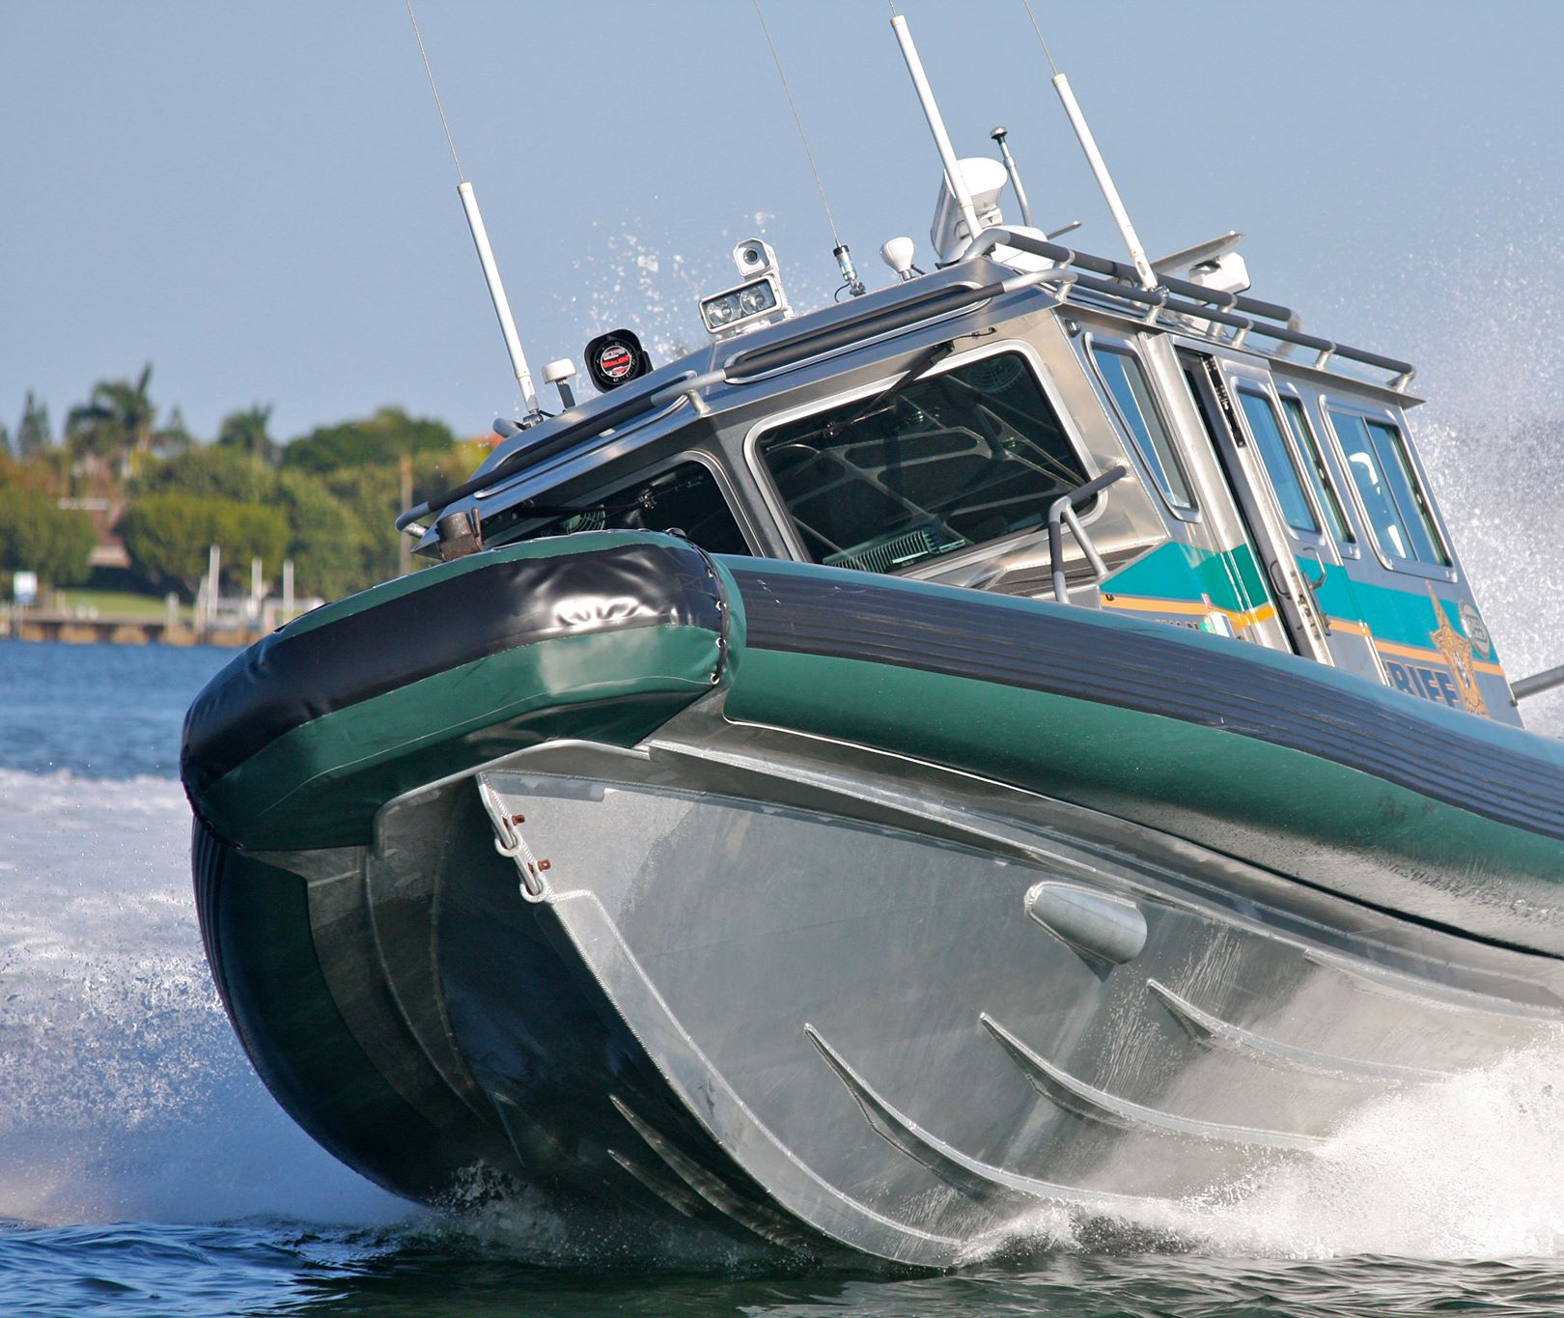
Law Enforcement

Slide 39
Law Enforcement
Level of Service
Service Area: Unincorporated County & 17 Cities
Variable | Weighted Population | Functional Population
Population | 943,870 | 749,358
Number of Sworn Officers | 1,664 | 1,664
LOS (Officers per 1,000 Population) | 1.76 | 2.22

Slide 40
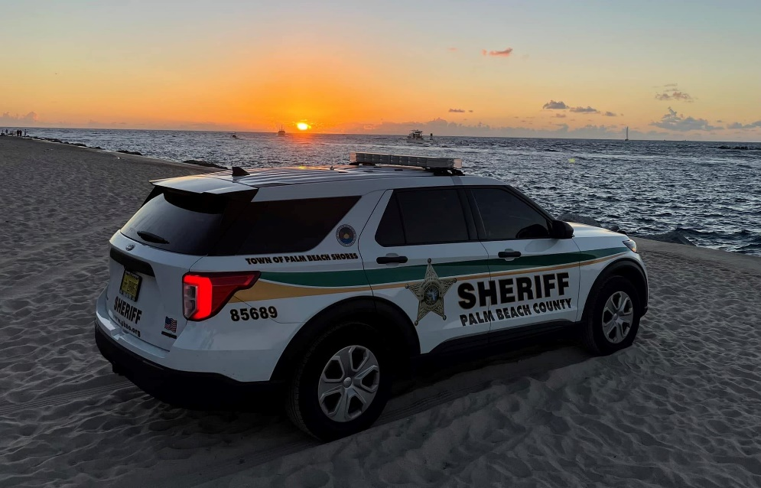
Law Enforcement
Cost Component
Component | Cost
Vehicle and Equipment Value per Officer | $55,000
LOS (Officers/1,000 functional residents) | 2.22
Cost per Functional Resident | $122.10

Slide 41
Law Enforcement
Calculated Impact Fee
Land Use | Unit | Functional Residents per Unit | Fully Calculated Fee | Current Adopted Fee | Maximum Allowable Fee*
Residential
Single Family (detached/attached) | du | 1.88 | $230 | $128 | $192
Multi-Family | du | 1.13 | $138 | $70 | $105
Non-Residential
Light Industrial | 1,000 sf | 0.48 | $59 | $7 | $10
Office | 1,000 sf | 0.98 | $120 | $10 | $15
Retail/Shopping Center (40,000 to 150,000 sfgla) | 1,000 sfgla | 2.58 | $315 | $57 | $85
*Over the next four years

Slide 42
Law Enforcement
Impact Fee Component Changes since 2014-18 Study:
Input Variable | 2014-18 Study (Not Adopted) | 2021 Study | % Change
Residential 2,000 – 3,599 sf (per du)
Total/Net Impact Cost per Functional Resident | $107 | $122 | +14%
Functional Residents per Unit | 1.80 | 1.88 | +4%
Calculated Impact Fee | $192 | $230 | +20%

Slide 43
Law Enforcement
Impact Fee Comparison
Land Use | Unit | Palm Beach County |  |  | Collier County | Martin County | Miami-Dade County | Orange County | St. Lucie County
 |  | Current Adopted | Fully Calculated | Maximum Allowable*
Study Date | - | 2012 | 2021 | N/A | 2016 | 2012 | N/A | 2017 | 2016
Assessed Portion | - | 95% | N/A | N/A | 100% | 100% | N/A | 100% | 100%
Residential
Single Family (2,000 sf) | du | $128 | $230 | $192 | $587 | $760 | $583 | $502 | $246
Multi-Family (1,300 sf) | du | $70 | $138 | $105 | $297 | $760 | $583 | $194 | $171
Non-Residential
Light Industrial | 1,000 sf | $7 | $59 | $10 | $215 | $158 | $405 | $146 | $54
Office (50,000 sf) | 1,000 sf | $10 | $120 | $15 | $372 | $274 | $405 | $265 | $187
Retail (125,000 sf) | 1,000 sfgla | $57 | $315 | $85 | $765 | $742 | $405 | $786 | $325
*Over the next four years

Slide 44
Law Enforcement
Revenue Projections
Based on permitting levels from 2015+
Full calculated rates ≈$0.6 million per year
Max allowable rates ≈$0.5 million per year
Examples of projects eligible for impact fee funding
Additional vehicles/equipment (new)

Slide 45
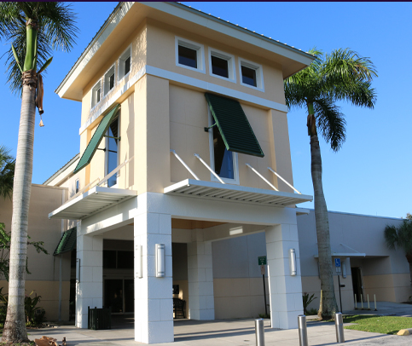
Library Facilities

Slide 46
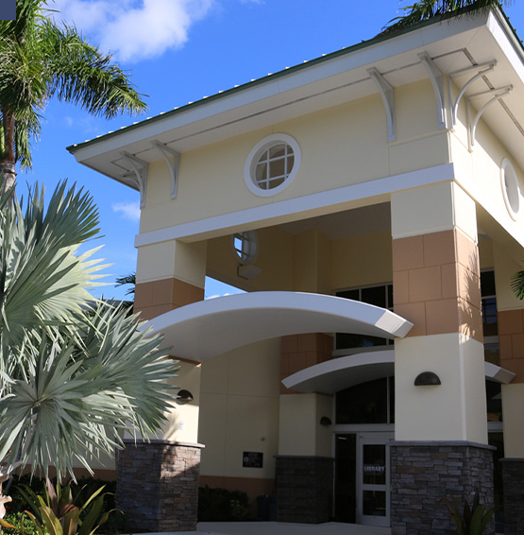
Library Facilities
Inventory
18 Library Facilities
≈405,700 total square feet
≈85 acres of land
Collection/Materials
Unit Costs:
Land: $100,000 per acre
Buildings: $386 per square foot (Libraries: $400 per sf / Annex: $175 sf)

Slide 47
Library Facilities
Level of Service
Service Area: Unincorporated County & 24 Cities
Category | Sq Ft/ Count | Service Area Population | Current LOS | Adopted LOS
Library Buildings | 405,747 | 1,034,445 | 0.39 | 0.60
Library Materials/Equipment | 1,548,970 | 179,541 | 1.50 | 2.50
Other Library Equipment | 426 |  | 0.0004 | N/A

Slide 48
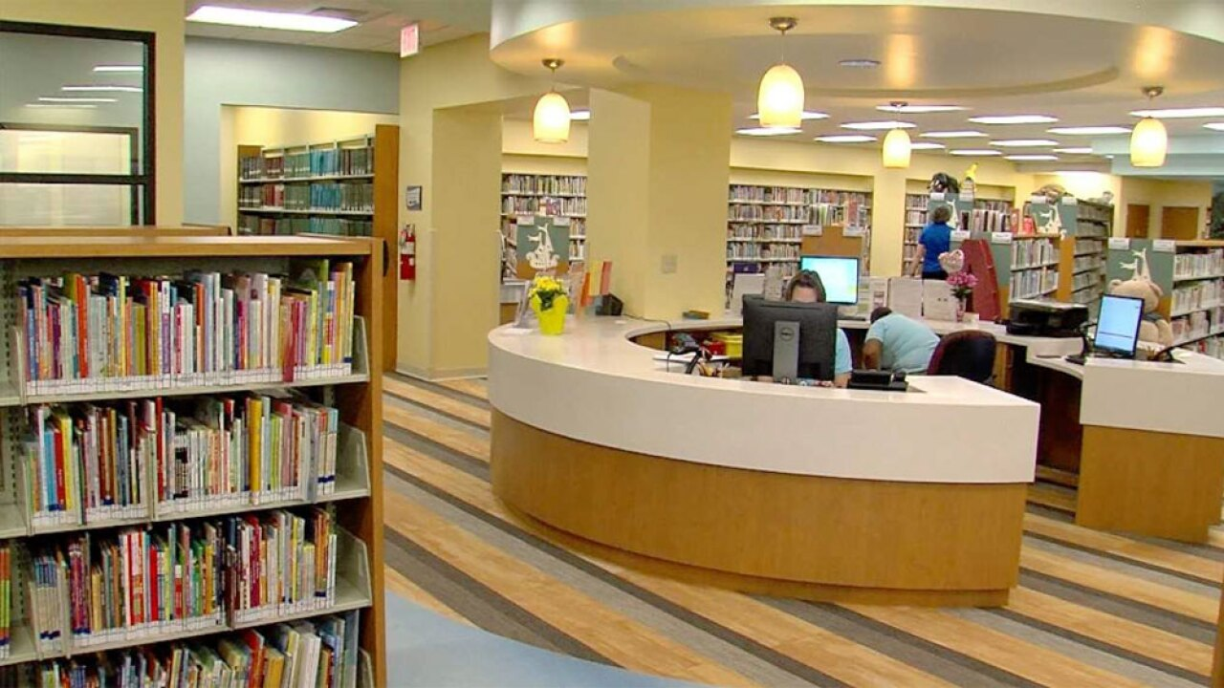
Library Facilities
Cost Component
Variable | Libraries | % of Total
Building Value | $156.8 M | 79%
Land Value | $8.4 M | 4%
Materials Value | $27.9 M | 14%
Equipment Value | $5.1 M | 3%
Total Asset Value | ≈$198.2 M | 100%
Service Area Population | 1,034,445 | -
Total Impact Cost per Resident | ≈$191 | -

Slide 49
Library Facilities
Credit Component: Annual Cash Credit
Variable | Total FY 2016-2025
Ad Valorem – Canyon Branch | $17,130,000
Average Annual Capital Expansion Expenditures | $1,713,000
Average Annual Population | 1,028,697
Annual Capital Expansion Expenditures per Resident | $1.67
Credit Adjustment Factor | 1.70
Annual Capital Expenditure per Resident | $2.84

Slide 50
Library Facilities
Credit Component: Debt Service
Description | Funding Source | # of Remaining Payments | PV of Remaining Payments | Avg Annual Functional Population | Credit per Functional Resident
$19.5 M General Obligation Refunding Bonds, Series 2010 | Ad‐Valorem Tax Dollars | 2 | $4,120,000 | 1,052,045 | $3.92
$11.9 M Refunding Bonds, Series 2014 (Library Facilities) | Ad‐Valorem Tax Dollars | 4 | $5,899,714 | 1,063,989 | $5.54
Total Debt Service Credit per Resident |  |  |  |  | $9.46
Credit Adjustment Factor |  |  |  |  | 1.70
Adjusted Debt Service Credit per Resident |  |  |  |  | $16.08

Slide 51
Library Facilities
Credit Component: Total Credit
Variable | Credit
Revenue Credit:
Average Annual Capital Improvement Credit | $2.84
- Capitalization Rate | 2.4%
- Capitalization Period (years) | 25
Capital Improvement Credit per Resident] | $52.93
Debt Service
Debt Service Credit per Resident | $16.08
Total Credit
Total Credit per Resident | $69.01

Slide 52
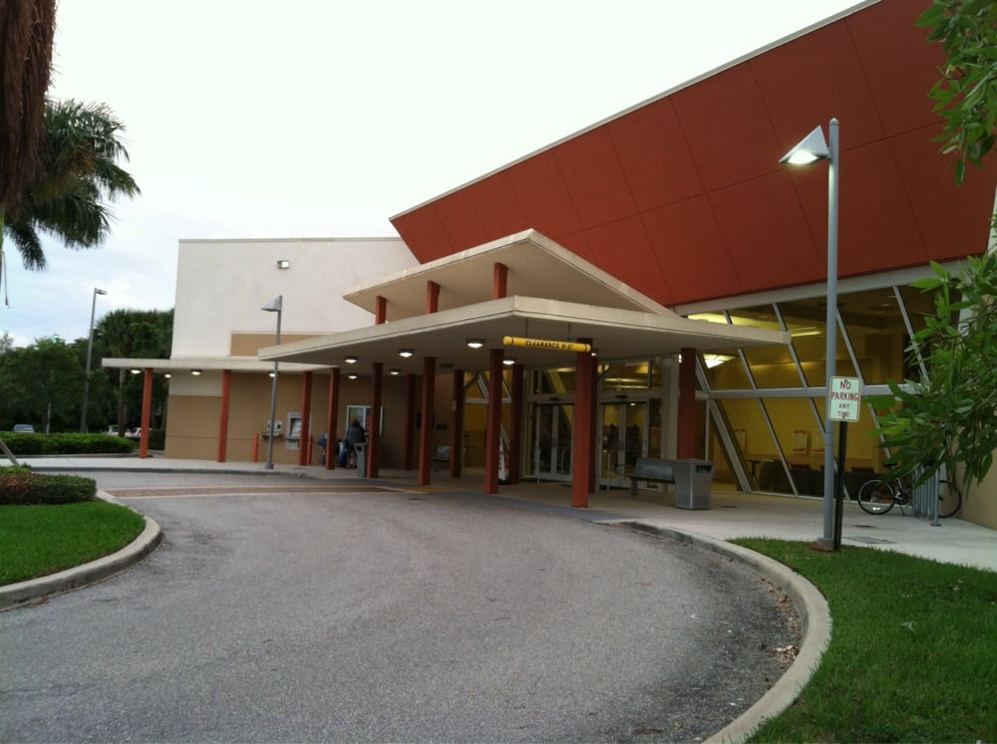
Library Facilities
Net Impact Cost
Variable | Cost/Credit
Impact Cost
Total Impact Cost per Resident | $191
Revenue Credit
Total Credit per Resident | $69
Net Impact Cost
Net Impact Cost per Resident | $122

Slide 53
Library Facilities
Calculated Impact Fee
Residential Land Use | Unit | Residents per Unit | Fully Calculated Fee | Current Adopted Fee | Maximum Allowable Fee*
Residential
800 sq ft & Under | du | 1.49 | $181 | $125 | $181
801 – 1,399 sq ft | du | 2.05 | $249 | $186 | $249
1,400 – 1,999 sq ft | du | 2.33 | $283 | $212 | $283
2,000 – 3,599 sq ft | du | 2.56 | $311 | $243 | $311
3,600 & Over sq ft | du | 2.75 | $334 | $267 | $334
*Over the next four years

Slide 54
Library Facilities
Impact Fee Component Changes since 2014-18 Study:
Input Variable | 2014-18 Study (Not Adopted) | 2021 Study | % Change
Residential 2,000 – 3,599 sf (per du)
Total Impact Cost per Resident | $182 | $191 | +5%
Total Credit per Resident | $70 | $69 | -2%
Net Impact Cost per Resident | $112 | $122 | +5%
Residents per Unit | 2.40 | 2.56 | +7%
Calculated Impact Fee | ≈$266 | $311 | +16%

Slide 55
Library Facilities
Impact Fee Comparison
Land Use | Unit | Palm Beach County |  |  | Collier County | Martin County | St. Lucie County
Land Use | Unit | Current Adopted | Fully Calculated | Maximum Allowable* | Collier County | Martin County | St. Lucie County
Study Date | - | 2012 | 2021 | N/A | 2016 | 2012 | 2017
Assessed Portion | - | 75% | N/A | N/A | 100% | 100% | 100%
Residential
Single Family (2,000 sf) | du | $243 | $311 | $311 | $336 | $537 | $276
Multi-Family (1,300 sf) | du | $186 | $249 | $249 | $160 | $537 | $192
Mobile Home (1,300 sf) | du | $186 | $249 | $249 | $270 | $537 | $174
*Over the next four years

Slide 56
Library Facilities
Revenue Projections
Based on permitting levels from 2015+
Full calculated/max allowable rates ≈$0.9 million per year
Examples of projects eligible for impact fee funding
Canyon Branch Library: $20.6 million

Slide 57

Parks & Recreation

Slide 58
Parks & Recreation
Level of Service
Service Area: Countywide
Variable | Acres | Achieved LOS | Adopted LOS Standard
Total Acres
Regional | 5,516.31 | 3.45 | 3.31
Beach | 471.77 | 0.30 | 0.29
District | 2,049.22 | 1.28 | 1.22
Total | 8,037.30 | 5.03 | 4.82
2021 Countywide Service Area Population | 1,598,324

Slide 59
Parks & Recreation
Cost Component
Description | Regional | Beach | District | Total/Weighted Average
Land Value
Land Purchase Cost per Acre | $80,000 | $950,000 | $70,000 | $128,517
Total Acres | 5,516.31 | 471.77 | 2,049.22 | 8,037.30
Total Land Value | $441.3 M | $448.2 M | $143.4 M | $1.03 B
Park Development and Facility Value
Park Development and Facility Value per Acre | $100,000 | $800,000 | $300,000 | $182,390
Developed Acres | 4,197.24 | 296.14 | 1,385.19 | 5,878.57
Total Park Development and Facility Value | $419.7 M | $236.9 M | $415.6 M | $1.1 B
Total Land and Facility Value | $861.0 M | $685.1 M | $559.0 M | $2.1 B
Total Facility Value per Acre | $156,088 | $1,452,177 | $272,788 | $261,919
Adopted LOS Standard | 3.31 | 0.29 | 1.22 | 4.82
Total Land and Facility Value per Resident | $516.65 | $421.13 | $332.80 | $1,270.58

Slide 60
Parks and Recreation
Credit Component: Annual Cash Credit
Variable | Total FY 2016-2021
Local Government One-Cent Infrastructure Surtax: | $14,519,797
Ad Valorem / Grants: | $3,609,099
Total Cash Credit | $18,128,896
Average Annual Expenditures | $3,021,483
Average Annual Permanent Population ‐ Countywide | 1,553,645
Average Annual Expenditures per Resident | $1.94
Portion Funded with Ad Valorem Revenues | $0.39
Portion Funded with Non-Ad Valorem Revenues | $1.55
Credit Adjustment Factor | 1.70
Residential Land Uses: Adjusted Capital Expansion Credit per Resident | $2.21

Slide 61
Parks & Recreation
Credit Component: Debt Service
Description | # of Remaining Payments | PV of Remaining Payments | Avg Annual Functional Population | Credit per Functional Resident
Series 2010 – Recreation and Cultural Facilities | 4 | $2,110,501 | 1,643,972 | $1.28
Series 2014 – Waterfront Access | 5 | $15,630,456 | 1,652,533 | $9.46
Total Debt Service Credit Per Resident |  |  |  | $10.74
Credit Adjustment Factor |  |  |  | 1.70
Residential Land Uses: Adjusted Debt Service Credit per Resident |  |  |  | $18.26

Slide 62
Parks & Recreation
Credit Component: Total Credit
Variable | Cost /Credit
Cash Credit
Annual Capital Improvement Credit per Resident
- Residential Land Uses | $2.21
- Non-Residential Land Uses | $1.94
Capitalization Rate | 2.4%
Capitalization Period | 25
Capital Improvement Credit per Resident
- Residential Land Uses | $41.19
- Non-Residential Land Uses | $36.16
Variable | Credit
Debt Service
Debt Service Credit per Resident
- Residential Land Uses | $18.26
- Non-residential Land Uses | $10.74
Total Credit
Total Credit per Resident
- Residential Land Uses | $59.45
- Non-residential Land Uses | $46.90

Slide 63
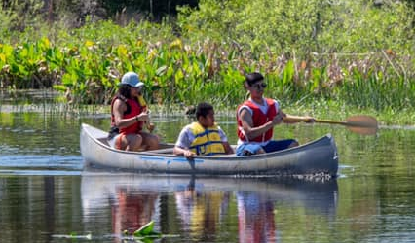
Parks & Recreation
Net Impact Cost
Variable | Cost /Credit
Impact Cost
Total Impact Cost per Resident | $1,271
Revenue Credit
Total Impact Credit
- Residential Land Uses | $60
- Non-residential Land Uses | $47
Net Impact Cost
- Residential Land Uses | $1,211
- Non-Residential Land Uses | $1,224

Slide 64
Parks & Recreation
Calculated Impact Fee
Residential Land Use | Unit | Residents per Unit | Fully Calculated Fee | Current Adopted Fee | Maximum Allowable Fee*
Residential
800 sq ft & Under | du | 1.43 | $1,732 | $366 | $549
801 – 1,399 sq ft | du | 1.96 | $2,374 | $734 | $1,101
1,400 – 1,999 sq ft | du | 2.23 | $2,701 | $788 | $1,182
2,000 – 3,599 sq ft | du | 2.45 | $2,967 | $860 | $1,290
3,600 & Over sq ft | du | 2.63 | $3,185 | $818 | $1,227
Transient, Assisted Group | du
Hotel/Motel | du | 1.47 | $1,799 | $273 | $409
Congregate Living Facility | du | 0.84 | $1,028 | $273 | $409
*Over the next four years

Slide 65
Parks & Recreation
Impact Fee Component Changes since 2014-18 Study:
Input Variable | 2014-18 Study (Not Adopted) | 2021 Study | % Change
Residential 2,000 – 3,599 sf (per du)
Total Impact Cost per Resident | $466 | $1,271 | +172%
Total Credit per Resident | $40 | $60 | +50%
Net Impact Cost per Resident | $426 | $1,211 | +184%
Residents per Unit | 2.30 | 2.45 | +7%
Calculated Impact Fee | ≈$979 | $2,967 | +203%

Slide 66
Parks & Recreation
Impact Fee Comparison
Land Use | Unit | Palm Beach County |  |  | Broward County | Collier County | Hillsborough County | Martin County
Land Use | Unit | Current Adopted | Fully Calculated | Maximum Allowable* | Broward County | Collier County | Hillsborough County | Martin County
Study Date | - | 2012 | 2021 | N/A | N/A | 2016 | 2020 | 2012
Assessed Portion | - | 95% | N/A | N/A | N/A | 100% | 55% | 100%
Residential
Single Family (2,000 sq ft) | du | $860 | $2,967 | $1,290 | $519 | $3,628 | $1,815 | $1,972
Multi-Family (1,300 sq ft) | du | $734 | $2,374 | $1,101 | $371 | $1,685 | $1,447 | $1,972
Mobile Home (1,300 sq ft) | du | $734 | $2,374 | $1,101 | $528 | $2,862 | $1,447 | $1,972
*Over the next four years

Slide 67
Parks and Recreation
Impact Fee Comparison (continued)
Land Use | Unit | Palm Beach County |  |  | Miami-Dade County | St. Lucie County | Orange County
Land Use | Unit | Current Adopted | Fully Calculated | Maximum Allowable* | Miami-Dade County | St. Lucie County | Orange County
Study Date | - | 2012 | 2021 | N/A | N/A | 2017 | 2017
Assessed Portion | - | 95% | N/A | N/A | N/A | 100% | 100%
Residential
Single Family (2,000 sq ft) | du | $860 | $2,967 | $1,290 | $2,613-$4,154 | $1,707 | $1,721
Multi-Family (1,300 sq ft) | du | $734 | $2,374 | $1,101 | $1,619-$2,439 | $1,523 | $1,165
Mobile Home (1,300 sq ft) | du | $734 | $2,374 | $1,101 | $2,613-$4,154 | $1,118 | $1,283
*Over the next four years

Slide 68
Parks and Recreation
Review of Benefit Districts:
Based on:
Geographic boundaries
Location of existing parks & future projects
Impact fee revenue and expenditure distribution
Visitation data from Palm Beach County
Recommendations:
Single district for regional parks
Two districts for districts parks

Slide 69
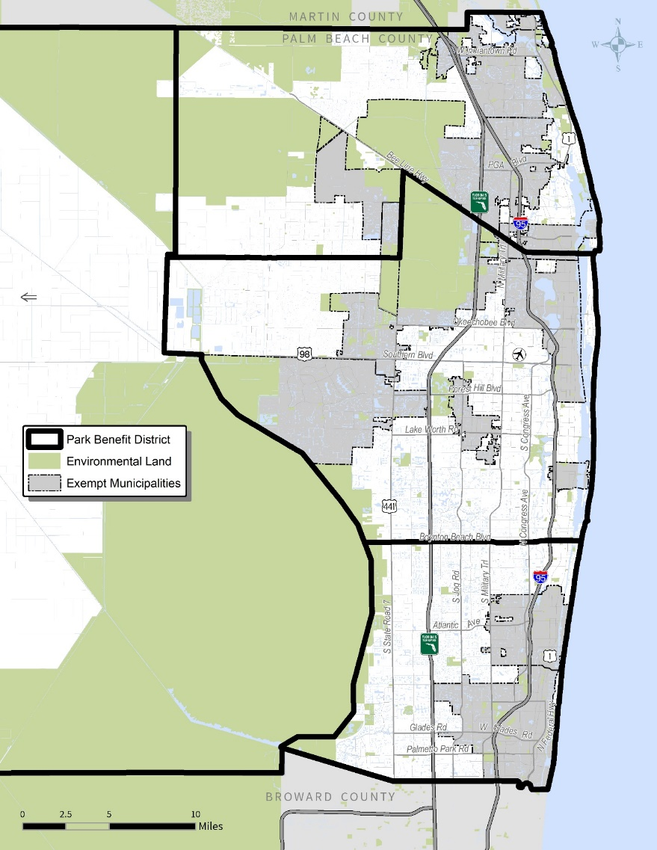
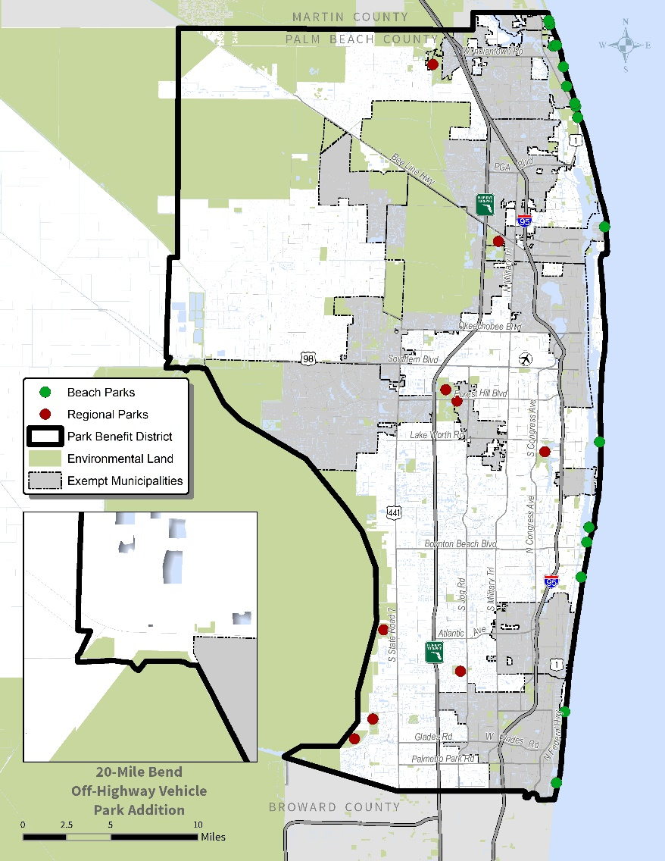
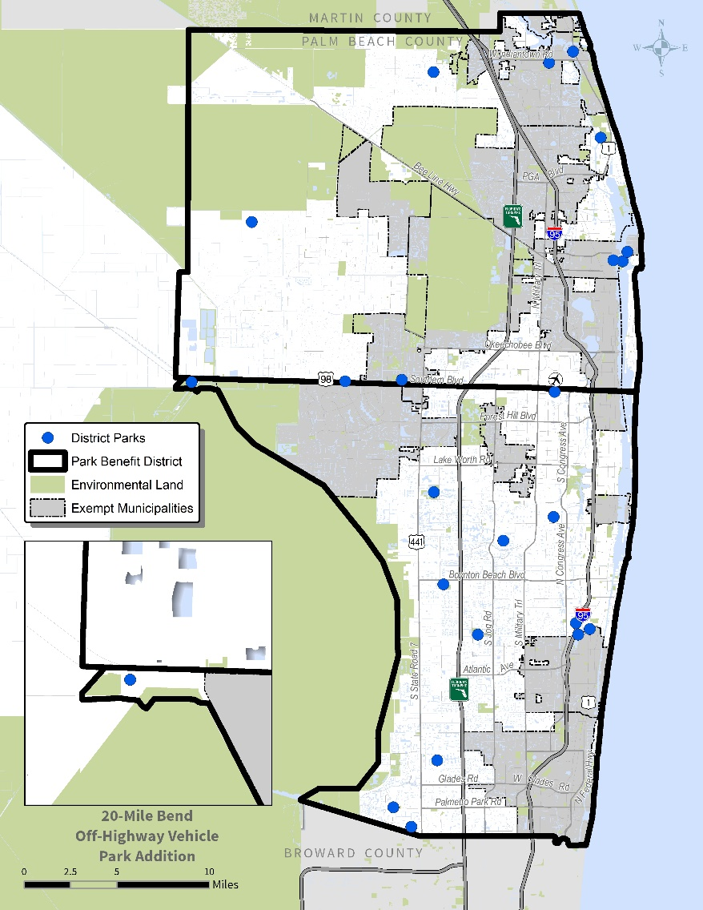
Parks & Recreation
Existing Parks & Rec Benefit Zones
Proposed – Beach & Regional Parks
Proposed – District Parks
Zone 1
Zone 1
Zone 2
Zone 3
Zone 2

Slide 70
Parks and Recreation
Revenue Projections
Based on permitting levels from 2015+
Full calculated rates ≈$10.2 million per year
Max allowable rates ≈$4.6 million per year

Slide 71
Parks and Recreation
Revenue Projections
Examples of projects eligible for impact fee funding
Villages of Windsor Park: $8 million
Milani Park: $3 million
West Delray Regional Expansion: $2 million
Okeeheelee South Phase 3 Development: $25 million
John Prince Park Mound Circle Phase 2: $2.2 million
Karen Marcus Preserve Park: $15 million
Lantana District “I” Property: $15 million
Sansbury Way Property: $15 million

Slide 72
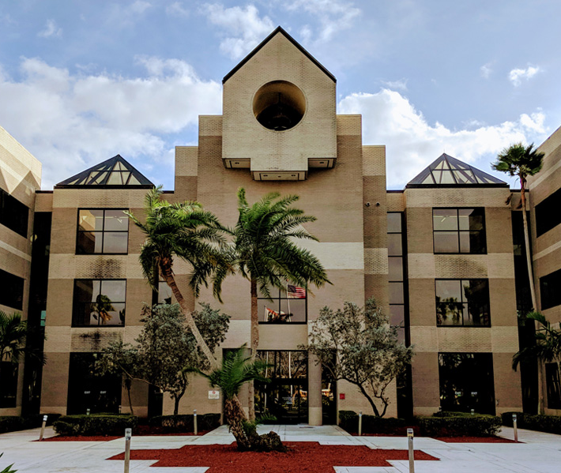
School Facilities

Slide 73

School Facilities
Inventory
103 Elementary Schools
33 Middle Schools
24 High Schools
8 Multi-level Schools

Slide 74
School Facilities
Facility Cost per Student Station:
Costs necessary to build schools
Architect/site improvements
Construction
Furniture, fixtures, and equipment (FF&E)
Based on estimates included in FY 2021-30 Capital Plan
Excludes costs associated with land purchase, transportation & ancillary facilities

Slide 75
School Facilities
Cost Component
Cost Component | Total Cost | Permanent Student Stations | Total Cost Per Station
Palm Beach County FY 2021 – 2030 Capital Plan
- Boca Raton Area Elementary School | $31.15 M | 972 | $32,052
- West Acreage Area Elementary School | $29.89 M | 970 | $30,810
- Scripps / Gardens Area Elementary School | $29.89 M | 970 | $30,810
Subtotal – Elementary | $90.93 M | 2,912 | $31,224
- Sunset Palms Middle School | $46.02 M | 1,459 | $31,542
- West Delray Area K-8 School | $42.00 M | 1,500 | $28,000
Subtotal – Middle/K-8 | $88.02 M | 2,959 | $29,746
Greater Lake Worth Area High School | $103.09 M | 2,703 | $38,140
Western Communities High School | $92.98 M | 2,697 | $34,477
Subtotal - High | $196.08 M | 5,400 | $36,311
Total/Weighted Average – All Levels | $375.02 M | 11,271 | $33,273

Slide 76
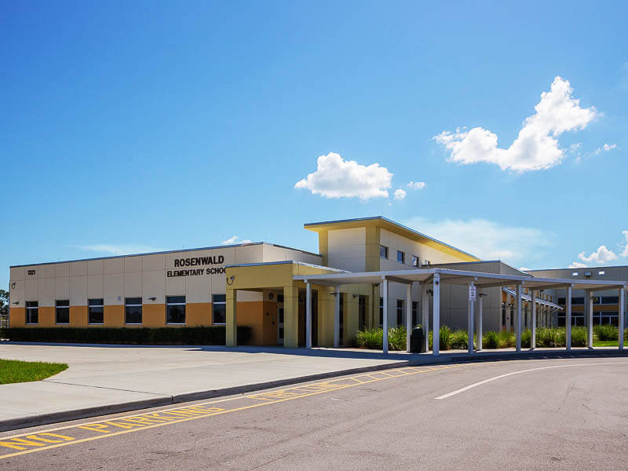
School Facilities
Total Facility Impact Cost per Student
Calculation Step | Weighted Average/Total
Facility Cost per Student Station | $33,273
Existing (2021) Permanent Capacity | 197,178
Existing (2019-2020) Student Enrollment | 174,637
Ratio of Permanent Capacity to Enrollment | 113%
Adopted LOS Standard | 100%
Total Facility Impact Cost per Student | $33,273

Slide 77
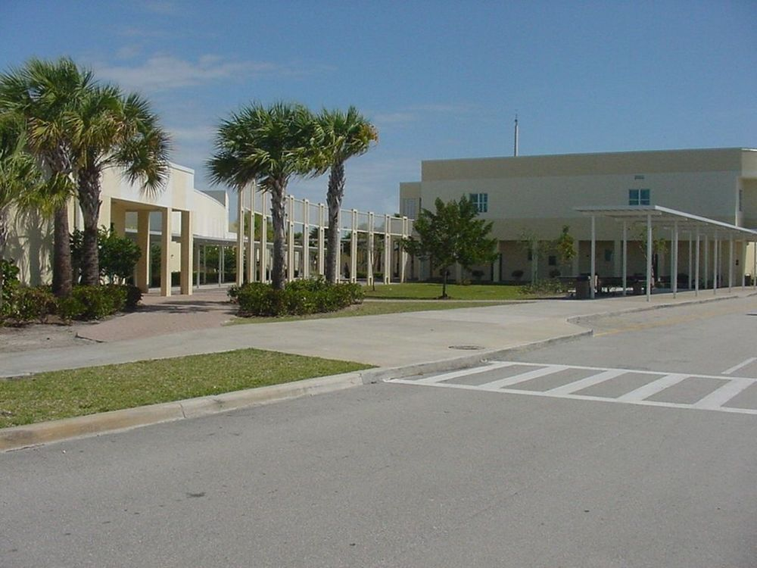
School Facilities
Credit Component: Annual Cash Credit
Revenue Credit | Total 2016-2020
Capital Improvement Tax/Local Funding | $6,312,925
State Funding | $15,000
Total Cash Credit | $6,327,925
Average Annual Capital Expansion Expenditures | $1,265,585
Average Enrollment | 171,941
Revenue Credit per Student | $7.36
Credit Adjustment Factor | 1.70
Adjusted Revenue Credit per Student | $12.51

Slide 78
School Facilities
Credit Component: Debt Service
Variable | Debt Service Credit per Student
Total Debt Service Credit per Student | $2,807
Credit Adjustment Factor | 1.70
Adjusted Total Debt Service Credit per Student | $4,772

Slide 79
School Facilities
Credit Component: Total Credit
Revenue Credit | Figure
Revenue Credit
Adjusted Revenue Credit per Student | $12.51
Capitalization Rate | 4.0%
Capitalization Period (Years) | 25
Total Capital Improvement Credit per Student | $195
Debt Service
Debt Service Credit per Student | $4,772
Total Credit
Total Revenue Credit per Student | $4,967

Slide 80
School Facilities
Net Impact Cost
Variable | Cost/Credit
Impact Cost
Total Impact Cost | $33,273
Revenue Credit
Total Revenue Credit per Student | $4,967
Net Impact Cost
Net Impact Cost per Student | $28,306

Slide 81
School Facilities
Student Generation Rates:
Based on current student addresses matched with land use classification
All residential categories are combined & tiered
Age restricted housing units are excluded
Better accounting of these units

Slide 82
School Facilities
Student Generation Rates (Traditional Schools)
Land Use | Total Housing Units | Number of Students | Students per Unit | 2018 Students per Unit | % Change
Residential
800 sf & Under | 49,705 | 12,866 | 0.259 | 0.114 | 127%
801 to 1,399 sf | 231,077 | 71,615 | 0.310 | 0.209 | 48%
1,400 to 1,999 sf | 153,887 | 43,957 | 0.286 | 0.297 | -4%
2,000 to 3,599 sf | 124,581 | 36,595 | 0.294 | 0.319 | -8%
3,600 sf or more | 27,073 | 6,111 | 0.226 | 0.314 | -28%
Total/Weighted Average | 586,323 | 171,144 | 0.292 | 0.250 | 17%

Slide 83
School Facilities
Student Generation Rates (Traditional Schools)
Land Use | Total Housing Units | Number of Students | Students per Unit | 2018 Students per Unit | SGR % Change | Housing Units % Change | Students % Change
Residential
800 sf & Under | 49,705 | 12,866 | 0.259 | 0.114 | 127% | -28% | 65%
801 to 1,399 sf | 231,077 | 71,615 | 0.310 | 0.209 | 48% | -7% | 37%
1,400 to 1,999 sf | 153,887 | 43,957 | 0.286 | 0.297 | -4% | 19% | 14%
2,000 to 3,599 sf | 124,581 | 36,595 | 0.294 | 0.319 | -8% | -8% | -15%
3,600 sf or more | 27,073 | 6,111 | 0.226 | 0.314 | -28% | -55% | -68%
Total/Weighted Average | 586,323 | 171,144 | 0.292 | 0.250 | 17% | -9% | 6%

Slide 84
School Facilities
Calculated School Impact Fee Rates
Residential Land Use | Unit | Students per Unit | Net Impact Cost per Student | Fully Calculated Fee | Current Adopted Fee | Maximum Allowable Fee*
Residential
800 sf & Under | du | 0.259 | $28,306 | $7,331 | $2,362 | $3,543
801 to 1,399 sf | du | 0.310 | $28,306 | $8,775 | $4,330 | $6,495
1,400 to 1,999 sf | du | 0.286 | $28,306 | $8,096 | $6,153 | $8,096
2,000 to 3,599 sf | du | 0.294 | $28,306 | $8,322 | $6,608 | $8,322
3,600 sf or more | du | 0.226 | $28,306 | $6,397 | $6,506 | $6,397
*Over the next four years

Slide 85
School Facilities
Impact Fee Component Changes since 2014-18 Study:
Input Variable | 2014-18 Study (Adopted @95%) | 2021 Study | % Change
Residential 2,000 – 3,599 sf (per du)
Total Impact Cost per Student | $28,338 | $33,273 | +17%
Total Credit per Student | $6,531 | $4,967 | -24%
Net Impact Cost per Student | $21,807 | $28,306 | +30%
Student Generation Rate per Unit | 0.319 | 0.294 | -8%
Calculated Impact Fee | $6,956 | $8,322 | +20%

Slide 86
School Facilities
School Impact Fee Rate Comparison
Residential Land Use | Date of Last Update | Adoption % | Single Family Rate | SFR Rate @ 100%
Miami-Dade County | 1995 | 100% | $2,448 | $2,448
Marion County* | 2006 | 100% | $3,967 | $3,516
Citrus County | 2021 | 40% | $1,660 | $4,117
Volusia County | 2013 | 66% | $2,942 | $4,483
Indian River County | 2020 | 28% | $1,310 | $4,680
St Johns County | 2018 | 100% | $5,016 | $4,725
Flagler County | 2004 | 76% | $3,600 | $4,756
Nassau County | 2017 | 100% | $5,431 | $5,431
St Lucie County | 2009 | 100% | $6,786 | $5,447
All fees charged per dwelling unit; rate shown for 2,000 sf single family tier
*Fees suspended until January 2023

Slide 87
School Facilities
School Impact Fee Rate Comparison
Residential Land Use | Date of Last Update | Adoption % | Single Family Rate | SFR Rate @ 100%
Lee County | 2018 | 53% | $2,879 | $5,484
Martin County | 2012 | 100% | $5,567 | $5,567
Manatee County | 2017 | 100% | $6,127 | $6,127
Hernando County | 2019 | 50% | $3,167 | $6,352
Palm Beach County - Adopted | 2014-1 | 95% | $6,608 | $6,956
Sarasota County | 2015 | 26% | $2,032 | $7,835
Hillsborough County | 2020 | 100% | $8,227 | $8,227
Palm Beach County - Calculated | 2021 | N/A | N/A | $8,322
Lake County | 2019 | 100% | $8,927 | $8,927

Slide 88
School Facilities
School Impact Fee Rate Comparison
Residential Land Use | Date of Last Update | Adoption % | Single Family Rate | SFR Rate @ 100%
Pasco County | 2017 | 79% | $7,128 | $9,028
Broward County | 2017 | 74% | $7,047 | $9,516
Clay County | 2009 | 77% | $7,034 | $9,096
Orange County | 2020 | 96% | $9,148 | $9,513
Brevard County | 2015 | 50% | $5,097 | $10,193
Collier County | 2015 | 67% | $8,790 | $11,164
Seminole County | 2017 | 73% | $9,000 | $12,322
Osceola County | 2017 | 100% | $11,823 | $11,823

Slide 89
School Facilities
Revenue Projections
Based on permitting levels from 2015+
Full calculated rates ≈$32.2 million per year
Max allowable rates ≈$28.4 million per year
Examples of projects eligible for impact fee funding
Scripps/Gardens Area ES: $30 million
West Acreage Area ES: $30 million
Western Communities HS: $93 million
West Delray Area ES: $42 million

Slide 90

Transportation

Slide 91

Transportation: Consumption-Based
One Lane Mile ≈$5.6 M
÷
Capacity ≈14,000
=
Vehicle-miles of capacity ≈$400
Total Credit ≈$800
Net Fee ≈$5,900
Total Impact Cost ≈$6,700
≈
17 vehicle-miles of daily travel
X

Slide 92
Transportation
Demand Component
Sources:
National ITE Reference (11th Edition)
Florida Studies Database
Southeast Regional Planning Model (SERPM v8)
Demand Calculation:
Trip Gen. Rate x Trip Length x % New Trips

Slide 93
Transportation
Cost Component
Palm Beach County Roadway Improvements
Roebuck Rd from Jog Rd to Haverhill Rd
Lyons Rd from Clint Moore Rd to N. of LWDD L-39 Canal
Hood Rd from E. of Florida Turnpike to W. of Central Blvd
Silver Beach Rd from E. of Congress Ave to Old Dixie/Pres. Barack Obama Hwy
Construction Cost per Lane Mile ≈$3.5 Million
Recent new construction/lane addition projects throughout Florida
Construction Cost per Lane Mile ≈$3.7 Million

Slide 94
Transportation
Construction Costs Continue to Increase
Source: Florida Dept of Transportation, Long Range Estimates
Notes:
Adopted rates are based on 2018 study, where data was collected from 2014 to 2018

Slide 95
Transportation
Estimated Cost per Lane Mile
Phase | County Roads* | State Roads* | County & State Roads
Design | $347,000 | $481,000 | $438,000
Right-of-Way | $521,000 | $655,000 | $612,000
Construction | $3,475,000 | $4,368,000 | $4,082,000
CEI | $313,000 | $481,000 | $427,000
Total | $4,656,000 | $5,985,000 | $5,559,000
Lane Mile Distribution | 32% | 68% | 100%
*Includes slight cost reduction for future roads that will have open drainage design elements

Slide 96

Transportation
Credit Component:
$.01 penny
1 CENT
GAS TAX
PER GALLON

Slide 97

Transportation
Credit Component
State funding
Current County funding is primarily used for operations and maintenance
Road impact fees (and potentially state funding) will be used for future capacity expansion projects
This Photo by Unknown Author is licensed under CC BY

Slide 98
Transportation
Equivalent Pennies of Fuel Tax Revenue
Credit | Average Annual Expenditures | Value per Penny | Equivalent Pennies per Gallon
County Revenues | $1,740,000 | $5,364,469 | $0.003
State Revenues | $41,151,368 | $5,364,469 | $0.077
Total | $42,891,368 |  | $0.080

Slide 99
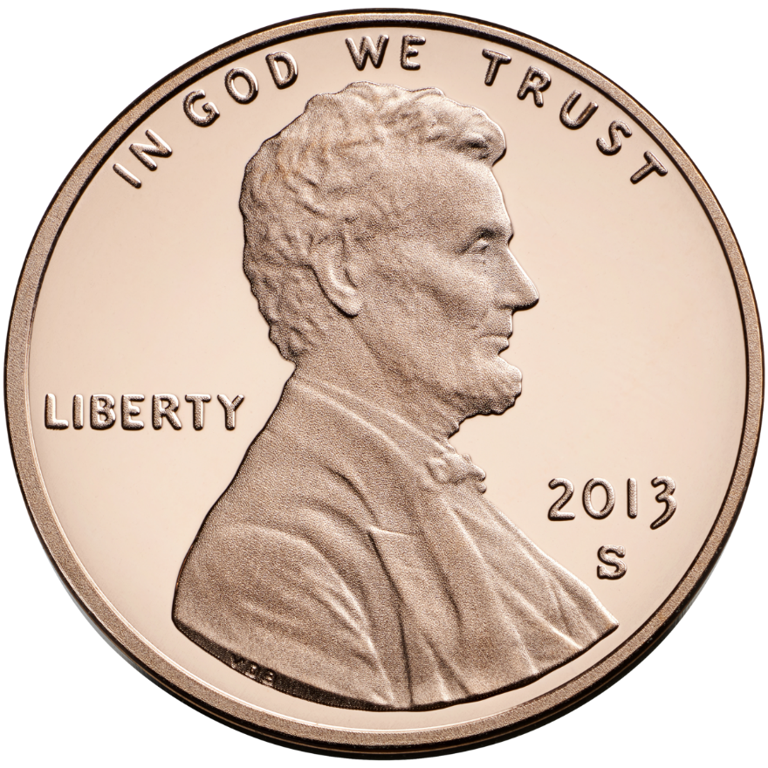
Transportation
Fuel Taxes:
State tax indexed
Local tax NOT indexed
Other revenue sources are indexed
This Photo by Unknown Author is licensed under CC BY-SA

Slide 100
Transportation Decrease in Value of 1¢ of Fuel Tax
State
≈ -20%
Local
Fuel Efficiency
Fuel Efficiency & Inflation
≈ -56%
Source: FHWA Highway Statistics Series

Slide 101
Transportation
Calculated Impact Fee:
Land Use | Unit | Fully Calculated Impact Fee | Current Adopted Impact Fee | Maximum Allowable Impact Fee*
Residential
Single Family (2,000 sq ft) | du | $5,892 | $4,717 | $5,892
Non-Residential
Light Industrial | 1,000 sf | $2,633 | $1,522 | $2,283
Office | 1,000 sf | $5,847 | $3,418 | $5,127
Retail (Commercial/Shopping Center) | 1,000 sfgla | $8,323 | $7,656 | $8,323
*Over the next four years

Slide 102
Transportation
Impact Fee Component Changes:
Input Variable | 2018 Study (Partially Adopted)* | 2021 Study | % Change
Single Family (per du)
Net Vehicle-Miles of Travel | 18.30 | 16.85 | -8%
Cost per Lane Mile | $3,622,000 | $5,559,000 | +53%
Capacity Added per Lane Mile | 11,533 | 14,000 | +21%
Cost per Vehicle-Mile of Capacity | ≈$314 | ≈$397 | +26%
County/State Credit | $783 | $801 | +2%
Calculated Impact Fee | $4,965 | $5,892 | +19%
*Full calculated rate is shown for comparison purposes. Fee was adopted at 95% ($4,717)

Slide 103
Transportation
Impact Fee Comparison
Land Use | Unit | Palm Beach County | Martin County | Broward County | Glades County | Miami-Dade County | St. Lucie County | Collier County | Highlands County | Orange County URBAN | Hillsborough County URBAN
Study Date | - | 2022 | 2020 | n/a | 2008 | 2006 | 2017/19 | 2019 | 2006 | 2020 | 2020
Assessed Portion | - | N/A | 100% | n/a | 100% | 100% | 100% | 87-100% | 25% | 100% | 80%
Single Family (2,000 sf) | du | $5,892 | $5,516 | $431 | $5,716 | $9,819 | $5,130 | $7,870 | $1,649 | $8,218 | $7,346
Light Industrial | 1,000 sf | $2,633 | $2,729 | $482 | $3,644 | $3,965 | $1,103 | $4,584 | $1,166 | $3,117 | $3,384
Office (50k sq ft) | 1,000 sf | $5,847 | $5,366 | $445 | $4,831 | $15,999 | $3,718 | $8,605 | $3,095 | $8,132 | $6,669
Retail (100k sq ft) | 1,000 sfgla | $8,323 | $8,503 | $410 | $8,636 | $20,824 | $6,341 | $13,774 | $2,455 | $11,052 | $10,850

Slide 104
Transportation
Revenue Projections
Based on permitting levels from 2015+
Full calculated rates ≈$24.3 million per year
Examples of projects eligible for impact fee funding
Lane additions
Intersection improvements

Slide 105
Summary
Summary of Calculated Impact Fee Rates:
Land Use | Unit | Public Buildings | Fire Rescue | Law Enforcement | Library Facilities | Parks & Recreation | School Facilities | Transportation | Total Calculated | Total Adopted
Residential
Single Family (2,000 sf) | du | $1,573 | $852 | $230 | $311 | $2,967 | $8,322 | $5,892 | $20,147 | $13,055
Non-Residential
Light Industrial | 1,000 sf | $466 | $193 | $59 |  |  | - | $2,633 | $3,351 | $1,683
Office (50,000 sf) | 1,000 sf | $951 | $114 | $120 |  |  | - | $5,847 | $7,032 | $3,609
Retail (125,000 sfgla) | 1,000 sfgla | $2,503 | $235 | $315 |  |  | - | $8,323 | $11,376 | $8,170

Slide 106
Summary
Summary of Maximum Allowable Impact Fee Rates:
Land Use | Unit | Public Bldgs | Fire Rescue | Law Enf | Library | Parks & Recr | School | Transp | Total Maximum Allowable* | Total Adopted
Residential
Single Family (2,000 sf) | du | $334 | $414 | $192 | $311 | $1,290 | $8,322 | $5,892 | $16,755 | $13,055
Non-Residential
Light Industrial | 1,000 sf | $110 | $120 | $11 |  |  | - | $2,284 | $2,525 | $1,683
Office (50,000 sf) | 1,000 sf | $196 | $75 | $15 |  |  | - | $5,127 | $5,413 | $3,609
Retail (125,000 sfgla) | 1,000 sfgla | $504 | $182 | $86 |  |  | - | $8,323 | $9,095 | $8,170
*Over the next four years

Slide 107
Presentation Overview
Background/Purpose
Technical Study
Public Buildings
Fire Rescue
Law Enforcement
Library Facilities
Parks & Recreation Facilities
School Facilities
Transportation
Next Steps

Slide 108
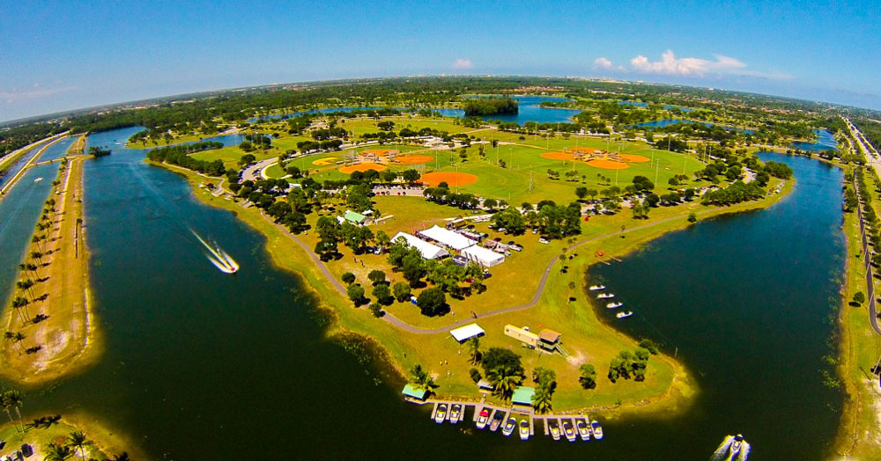
Next Steps
Impact Fee Review Committee Input
Final Technical Report
BOCC Workshop
Implementation Process

Slide 109
Questions?

Slide 110
School Facilities
Student Generation Rates (Traditional Schools)
Land Use | Total Housing Units |  | Age-Restricted Units |  | Housing Units Used in SGR
Land Use | 2020 | 2014 | 2020 | 2014 | 2020 | 2014 | % Change
Residential
800 sf & Under | 65,422 | 68,722 | 15,717 | 79 | 49,705 | 68,643 | -28%
801 to 1,399 sf | 286,503 | 252,105 | 55,426 | 2,652 | 231,077 | 249,453 | -7%
1,400 to 1,999 sf | 174,697 | 138,252 | 20,810 | 9,021 | 153,887 | 129,231 | 19%
2,000 to 3,599 sf | 133,805 | 145,537 | 9,224 | 9,809 | 124,581 | 135,728 | -8%
3,600 sf or more | 27,089 | 60,260 | 16 | 1 | 27,073 | 60,259 | -55%
Total/Weighted Average | 687,516 | 664,876 | 101,193 | 21,562 | 586,323 | 643,314 | -9%

Slide 111
School Facilities
Student Generation Rates (Traditional Schools)
Land Use | Number of Students
Land Use | 2020 | 2014 | % Change
Residential
800 sf & Under | 12,866 | 7,816 | 65%
801 to 1,399 sf | 71,615 | 52,244 | 37%
1,400 to 1,999 sf | 43,957 | 38,444 | 14%
2,000 to 3,599 sf | 36,595 | 43,266 | -15%
3,600 sf or more | 6,111 | 18,945 | -68%
Total/Weighted Average | 171,144 | 160,715 | 6%

