Slide 1


Certification 101
Presented by the Office of Small Business Assistance
Tonya Davis Johnson, Director

Slide 2
Why Certify?
Palm Beach County has a 15% SBE participation goal. Becoming a certified S/M/WBE puts your business in a position to help Palm Beach County meet that goal.
Certified SBEs are added to OSBA’s Vendor Directory, providing your business with partnership opportunities.
Being a certified SBE can help your business be awarded bids/quotes.
Certified SBEs gain the support of OSBA staff with bid writing and resolving payment issues, should they arise.

Slide 3
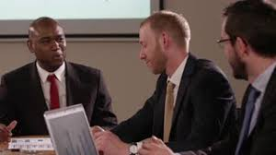
Who can become certified?
Businesses domiciled in Palm Beach County.
Businesses that are owned and operated by a citizen or lawful permanent resident of the United States.
Independent, for profit businesses that perform a commercially useful business function for Palm Beach County.
Small businesses whose averaged gross income over the previous 3 years does not exceed the following size standards:
Construction –$9 million
Commodities – $5 million
CCNA - $5 million
Professional Services (Non-CCNA) - $4 million

Slide 4

Getting Started
Download the certification application and instructions at discoverpbcgov.org/osba or stop by our office and pick up an application.
Register your business with the State of Florida at www.sunbiz.org as a for profit business.
Register as a vendor with Purchasing at pbcvssp.co.palm-beach.fl.us. If you do not have access to a computer, you may register at the Purchasing office.
Fully complete the application.
If you do not want your financial information to be made public, notify OSBA staff in writing to schedule an appointment to have your information reviewed.
A non-refundable $150 fee must be submitted in the form of a cashier’s check or money order payable to Palm Beach County BOCC.
You must submit a notarized affidavit, as part of the application. OSBA staff are available to notarize the affidavit for you at no charge.

Slide 5

What documents do I need to provide?
Palm Beach County Business Tax Receipt(s) and Municipal Business Tax Receipt(s) when applicable.
Copy of Professional License(s) or Certificate of Competency.
Fictitious Name Certificate, if applicable.
Most recent 3 years federal tax returns, including all schedules. Sole Proprietors must submit personal tax returns that include Schedule C.
For firms in business less than one year, submit opening balance sheet and income statements.
You must submit proof of completion of the Cornerstone Program, when applicable.
Proof of business location/operation in Palm Beach County (Lease Agreement, Lease Addendum, or Property Tax Bill.)
Proof of capital investment.
Copies of 3 current customer invoices, signed contracts, or proposals.
For a provider of CCNA Professional Services, submit a copy of your CCNA certification.

Slide 6

Documents Needed for Various Corporate Structures
Corporation
Articles of Incorporation, including date approved by State Department of Corporations, and any subsequent amendments
Corporate By-Laws
List of shareholders, copy of issued stock certificates (front and back); copy of stock ledger; and proof of stock purchase
List of Officers and Board of Directors
LLC
Operating Agreement
Membership Units
Ledger
Partnership
Partnership Agreement
Franchise
Franchise Agreement

Slide 7
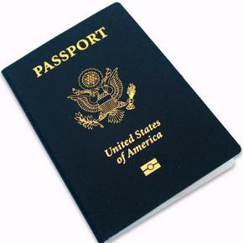

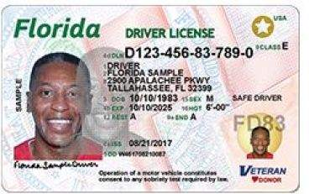
Additional Documentation Needed for Minority and Women Business Enterprises
Proof of gender and/or ethnicity
Examples of documents that can be used to provide proof of gender and/or ethnicity are:
Drivers License
Passport
Birth Certificate

Slide 8

Certification Process
OSBA has up to ninety (90) business days after all required documents have been received to complete your certification.
You may request an Expedited Review if you are submitting a proposal or bid to Palm Beach County. The Expedited Review request must be submitted fifteen (15) business days prior to bid opening to be considered. There is an additional fee of $150 for expedited processing.
Certification last for 3 years.
Palm Beach County, The City of West Palm Beach, and the School District of Palm Beach County have an Interlocal Agreement in place to reduce time and paperwork for businesses who want to become certified with additional agencies.

Slide 9
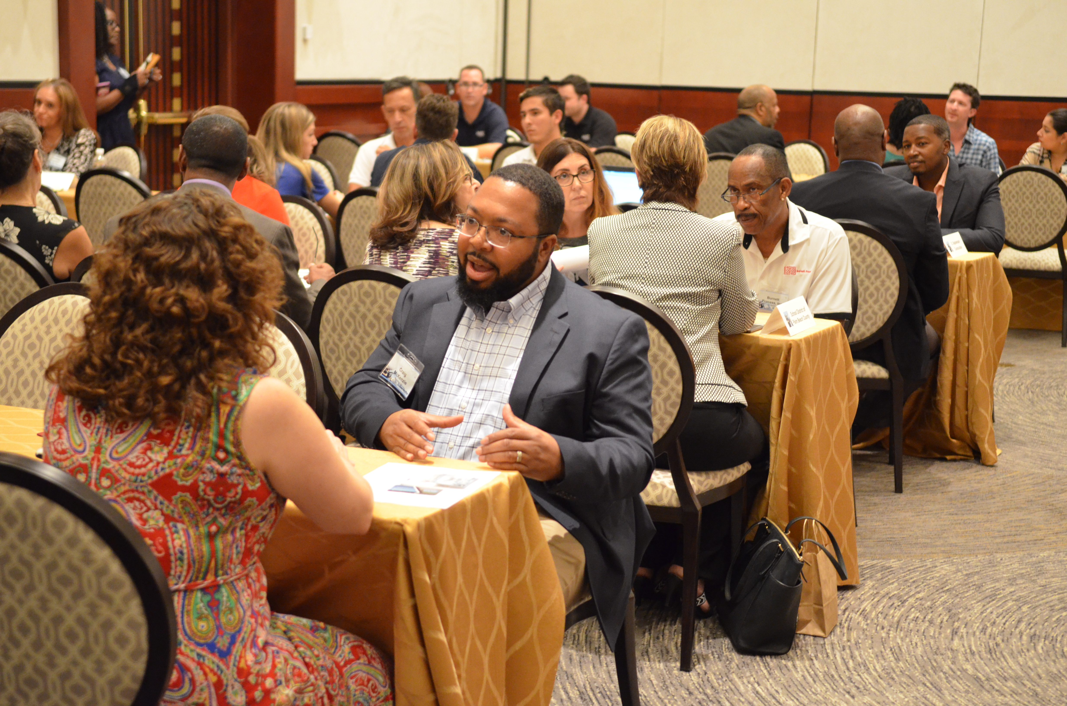
Now that I’m certified, what’s next?
MARKET YOUR CERTIFICATION!
Attend tradeshows such as Business Matchmaker to network and market your business.
Participate in outreach activities of local agencies.
Use the internet to check the websites of local, state, and federal agencies for opportunities.
Check publications such as Florida Trend, Fortune, and Bloomberg for information and opportunities.
Join local chambers and network.
Put yourself out there and pass out your business cards. You are the best advocate for your business.

Slide 10
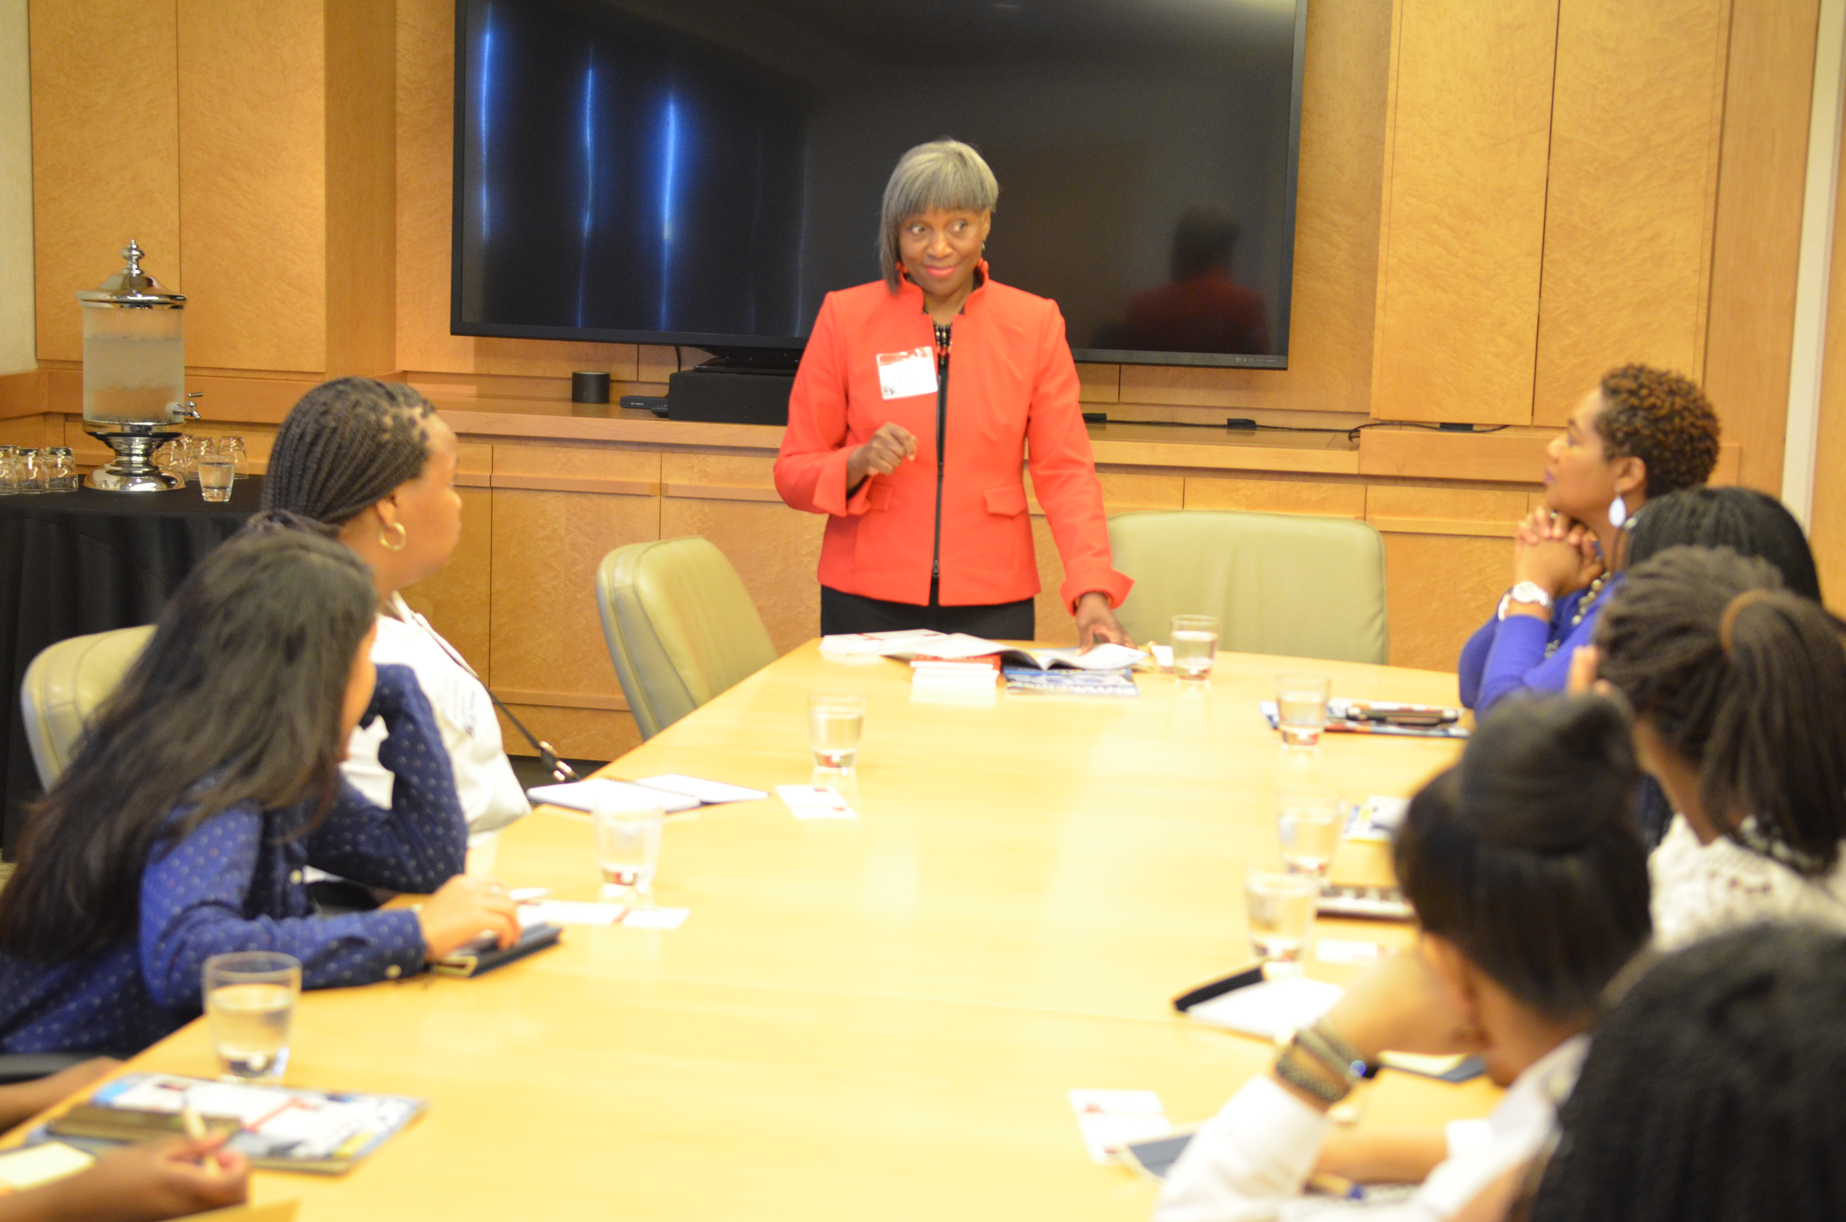
Education & Support
Your OSBA Business Specialist is here to answer questions and help resolve issues that sometimes occur.
Take advantage of educational opportunities through our partners such as Small Business Development Center, TED Center, and SCORE. They can provide assistance with business plans and bid writing.
Find a mentor. OSBA staff may have some suggestions, if you need assistance.

Slide 11
Contact Information
PBC Office of Small Business Assistance – SBE Certification
50 South Military Trail, Suite 202
(561) 616-6840
www.pbcgov/osba
PBC Purchasing Department – Registration, Business Opportunities
50 South Military Trail, Suite 110
(561) 616-6800
https://pbcvssp.co.palm-beach.fl.us/webapp/vssp/AltSelfService
PBC Engineering and Public Works Department – CCNA Certification
2300 N. Jog Road, Suite 3W-33
(561) 684-4150
http://discover.pbcgov.org/engineering/roadwayproduction/Pages/CCNA.aspx

Slide 12
Partners
City of Riviera Beach (561) 845-4883 or http://www.rivierabch.com/smallbusiness
City of West Palm Beach (561) 822-2103 or http://wpb.org/Departments/Procurement/Small-Business/Certification
School District of Palm Beach County (561) 681-2412 or https://www.palmbeachschools.org/diversityinbusiness/contactus
SCORE (561) 833-1672 or www.score.org
Small Business Development Center (954) 762-5129 or https://sbdc.fau.edu
The TED Center (561) 265-3790 or www.tedcenter.org
Solid Waste Authority of Palm Beach County (561) 640-4000 ext. 4529 or https://www.swa.org/279/Purchasing-Bids

Slide 13
Questions?

